Slide 1
Planning and Organizing
Organizational Skills Domain

Slide 2

Planning and Setting 4-H Club Goals
Meet with club officers
Gather input from other members and parents
Have members brainstorm, discuss, and become familiar with possible service activities
Consider if any goals are needed to retain the club charter, meet county program requirements
Set a few attainable goals

Slide 3

4-H Club Annual Plan of Meetings and Activities
Include a balance of time for education, leadership development, community service, and recreational activities
Cover the entire year but provide flexibility to include some unexpected events
review club goals and accomplishments at the end of the year

Slide 4

Committees Within the 4-H Club
Committees can
Make meetings more efficient
Spend time brainstorming options and developing alternatives
Plan programs, organize events, recruit members, fundraise, and develop community service projects
Have an adult volunteer or teen leader serve as an advisor, but should have a youth chairperson to lead the meeting and report progress

Slide 5

4-H Meeting Agenda
Include:
Pledges and roll call
Secretary and treasurer reports,
Committee reports,
Unfinished business,
New business,
Educational activities
Recreation and refreshments.
Announcements

Slide 6



For more information, contact:
Your Name, Your Title
your-email@fourhcouncil.edu

Slide 7
Activity – Instruction Prompts
Planning and organizing–
Organizational Skills Domain

Slide 8

Activity: Creating an Annual Plan for Your 4-H Club
With your partner or small group, use Handout 1 as a guide to create objectives, goals and action steps for planning club activities.
Next, brainstorm ideas for club activities on index cards.
Organize the cards into columns, grouping similar responses together.
After identifying the most popular activities that align with the goals and objectives, work together to fill in the grid (Handout 2 & 3) to create a balanced program for the year allocating time to education, leadership, community service and recreational activities.
Notes:
Activity Instructions
Creating an Annual Plan for Your 4-H Club
Use Handout 1 as a guide to create objectives, goals and action steps for planning club activities.
Ask participants to contribute their ideas for club activities on index cards.
Gather all the cards and have participants organize them into columns, grouping similar responses together.
After identifying the most popular activities that align with the goals and objectives, have participants work together to fill in the grid (Handout 2) to create a balanced program for the year allocating time to education, leadership, community service and recreational activities. See Handout 3 for a sample annual plan.

Slide 9
Activity: Developing a 4-H Club Meeting Agenda
Work with a partner to design a meeting agenda using Handout 4 as a template.
Be intentional about how you will create a sense of belonging.
Pair up with another group to discuss your meeting plan and offer feedback and suggestions.
Notes:
Activity Instructions
1. Review key components of a 4-H meeting- business meeting, educational component, and social activity.
2. Break participants into small groups to work together to design a meeting agenda using Handout 4 as a template.
3. Remind participants to be intentional about how they will create a sense of belonging.
4. Have participants pair up with another group to share draft agenda and provide feedback and suggestions to one another.

Slide 11
Time Management
Organizational Skills Domain

Slide 12

Time Management Success vs. Failure
Awareness- thinking realistically about your time by understanding it is a limited resource.
Arrangement- designing and organizing your goals, plans, schedules, and tasks to effectively use time.
Adaptation- monitoring your use of time and adjusting for interruptions or changing priorities.

Slide 13

Time Management Plan
On-going list projects, both short-term and long-term
Series of projects in priority order
Calendar blocking with detailed projects and time allotted
Allow time for activities that bring you joy, relaxation, and recreation
Notes:
List of projects
The simplest time plan is a list of large and small projects. These can be done as you have time and feel like doing them. When you have a lot of free time, this list may be all that you need to manage time effectively.
Series of projects
The series of projects is like the list of projects, but it involves putting the activities into an order of priority. Start with your list of large and small projects, and decide which activities must be done first, second, third, etc. For example, balancing your checkbook may be more important now than writing up the minutes of the last board meeting. You will, however, accomplish both tasks before spending time on trivial matters.
Detailed schedule
A detailed schedule includes both an order of projects and estimates of the time necessary for each project. This type of scheduling has special value to people whose obligations leave them with little free time. It is also important to those who are just beginning to manage time. You will need to look at your entire day or week and decide how important the various activities are, and how much time you will spend on them. If you know exactly what you are doing, why you are doing it, and approximately how long each task will take, you will work more effectively. While planning takes time at first, it saves time later.
Do not shortchange the need for time to do activities that bring you joy, relaxation, comfort, or rejuvenation. Your physical and emotional health benefits from scheduled personal time. This time is a personal investment in future productivity and can minimize burnout and procrastination². When we do not take the time to rest it only shortchanges our effectiveness the next day

Slide 14

Using Tech to Save Time
Google Calendar
Trello
Evernote
Forest
And so many more…
Notes:
Google Calendar - This free online calendar tool can help you keep track of important dates, deadlines, and meetings. You can set reminders and share your calendar with other members.
Trello - This project management tool can help you organize tasks and keep track of progress. Tasks can be organized by creating boards, lists, and cards to visualize work and collaborate with others. This is a great tool if you are planning a larger, more complex undertaking over time, like a fundraiser or big group project.
Evernote - This note-taking tool can help volunteers capture ideas, take notes, and store information. They can also use it to create to-do lists and set reminders.
Forest -This is a mobile app that helps users stay focused and avoid distractions. You can use it to set a timer for a task and earn rewards by staying focused for a certain amount of time.

Slide 15
For more information, contact:
Your Name, Your Title
your-email@fourhcouncil.edu

Slide 16
Activity – Instruction Prompts
Time management–
Organizational Skills Domain

Slide 17
Activity: How Do You Spend Your Time?
Time Challenge
Track your time for one week.
At the end of the week, circle the necessities.
Then, circle all the noteworthy accomplishments.
Analyze your time and notice patterns where you could gain more productive time.
Notes:
Activity Instructions
1. Challenge the group to track their time for one week to get an accurate idea of your daily time use. If you prefer, there are apps available to
track your time. Be honest about tracking how your time is spent.
2. At the end of the week, circle necessities such as sleeping, cooking, eating,
homework, housework, yard work, and exercise.
3. Then circle all of your noteworthy accomplishments— significant things that you “got done.”
4. With what remains, look at how much time is spent on fluff. Do you see patterns

Slide 18
Activity: Setting Priorities
Make a list of 10 things you need to do this week.
Star the ones that cannot be ignored.
Can you delegate any of these tasks to someone else? Put that person’s name beside that task. How do you ask for help?
Place 2 stars next to the tasks that need to be started today.
At the end of today, examine and celebrate the accomplishments you made.
Repeat each day and celebrate successes.
Notes:
Activity Instructions
1. List five to 10 things that you need to do this week.
Examples may include pay the rent/house mortgage on time, spend playtime with the children, planning meals and buying groceries, and getting to the dentist appointment on
Friday, check on a bill, fix the storm door, discard leftover food in the refrigerator more than three days old, do laundry, etc.
2. Put a star next to the ones that cannot be ignored.
3. Next, ask yourself if there are any tasks that can be delegated to another family member. Put that person’s name beside the task and decide when you will talk
with this person about the task.
4. Place two stars by those tasks that need to be started or done today.
5. Look at the list at the end of today and determine the accomplishments you have made. Make your list for tomorrow, indicating which tasks are a priority for that
day. Repeat, making a new list each day for a week.
Ask yourself: How are you doing in getting others to help? What is your success in completing tasks?
Source: Walker, D, Mark, E., Essential Living Skills: Time Management Skills, Kansas State University, pg 29, retrieved from https://bookstore.ksre.ksu.edu/pubs/S134F.pdf

Slide 20
Parent Recruitment and Involvement
Organizational Skills Domain

Slide 21
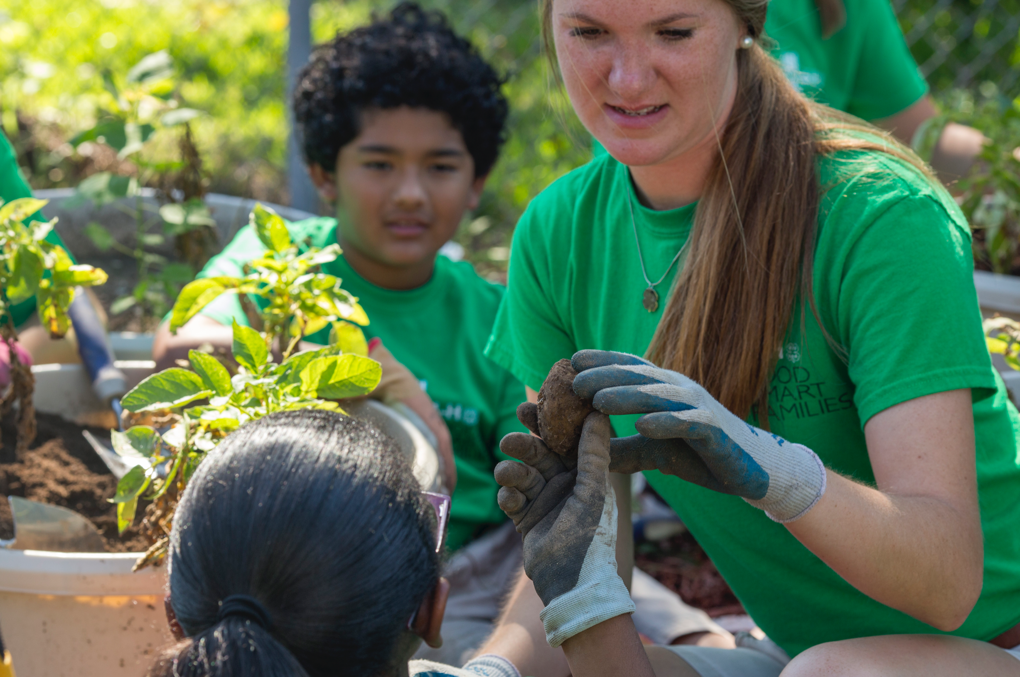
Key Factors of Parent/Guardian Engagement
Parents & Caregivers are Crucial
Consider Diversity and Community Demographics
Challenges Faced by Families
Motivations for Adult Participation
Strategies to Engage Parents/Guardians
Notes:
Importance of Parents and Caregivers: Parents and caregivers play a crucial role in the positive development of youth. They can provide essential guidance, particularly through ethnic-racial socialization, which prepares children for success in diverse communities.
Diversity and Demographic Trends: Demographic trends indicate that the U.S. is becoming increasingly diverse, and by 2060, a significant portion of the population will be Latino. This highlights the need for youth programs like 4-H to engage and recruit families from diverse cultural backgrounds effectively.
Challenges Faced by Families: Families often face logistical challenges when trying to participate in community programs, including busy schedules, transportation issues, and health challenges. Understanding and addressing these challenges can improve family engagement in programs like 4-H.
Motivations for Adult Participation: Research shows that adults become 4-H leaders primarily because they want to make a positive impact on the lives of young people and find satisfaction in helping others. These motivations can be leveraged to recruit and engage parents and caregivers.
Strategies for Engaging Parents: There are several effective strategies for engaging parents in youth programs, including creating welcoming environments, involving parents in goal-setting and program planning, surveying their interests and talents, sharing leadership responsibilities, and providing clear instructions for home activities that support their child's development.
These key points emphasize the importance of involving parents and caregivers in youth development programs like 4-H, especially in light of demographic shifts and the potential challenges that families may face. They also provide practical strategies for increasing engagement and recruitment of parents and caregivers.

Slide 22
For more information, contact:
Your Name, Your Title
your-email@fourhcouncil.edu

Slide 23
Activity – Instruction Prompts
Parent recruitment and involvement
Organizational Skills Domain

Slide 24
Activity: Exploring Cultural Backgrounds
Ask each person to reflect on their cultural backgrounds and experiences.
Record answers on a flip chart or use Google Jamboard or another digital system.
As a group, organize the responses into themes or categories to differentiate between clusters of responses.
Discuss ways these cultural values can promote engagement in the 4-H program.
As a group, brainstorm ways their 4-H program can support these cultural values to recruit and engage more parents.
Notes:
Author: Matthew Rodriguez, Ph.D., University of California

Slide 25
Activity: Understanding Parental Domains of Involvement
Reflect upon the different behaviors that parents do to support the 4-H program.
Reflect upon parents' thoughts about the 4-H program.
Reflect upon parents' feelings about the 4-H program.
Discuss results from each domain: behaviors, thoughts, and feelings.
Brainstorm recruitment strategies that consider each domain of involvement.
Notes:
Activity Instructions:
Ask participants to reflect upon the different behaviors that parents do to support the 4-H program.
Record answers on a flip chart or use a digital whiteboard.
Ask participants to reflect upon parents' thoughts about the 4-H program.
Record answers on a flip chart or use a digital whiteboard.
Ask participants to reflect upon parents' feelings about the 4-H program.
Record answers on a flip chart or use a digital whiteboard.
Discuss results from each domain: behaviors, thoughts, and feelings.
As a group, brainstorm recruitment strategies that consider each domain of involvement.
Author: Matthew Rodriguez, Ph.D., University of California

Slide 27
Delegating Tasks to Parents
Organizational Skills Domain

Slide 28

Benefits of Delegation
Increase knowledge, skills, and abilities.
Improve productivity.
Enhance adaptability.
Improve time management.
Decrease individual workload.
Build comradery and team spirit.
Improve retention.
Contribute to succession planning.
Notes:
The Importance of Delegation: Delegation is a critical leadership skill, both in professional and volunteer roles. It involves sharing tasks with others and can be challenging due to the need to relinquish control and allow others to work in their own style.
Benefits of Delegation: Learning and practicing delegation can have numerous benefits for leaders and their teams, including:
Increasing knowledge, skills, and abilities.
Improving productivity.
Enhancing adaptability.
Improving time management.
Decreasing individual workload.
Building comradery and team spirit.
Improving retention.
Contributing to succession planning.

Slide 29

Effective Delegation
Match tasks with individuals' skills and experiences.
Provide clear expectations and information.
Set realistic and achievable deadlines, with input from the assigned individual.
Schedule check-ins
Allow autonomy and avoid micromanagement.
Notes:
Steps for Effective Delegation: Leaders can follow a structured approach to delegation, including:
Matching tasks with individuals' skills and experiences.
Providing clear expectations and information.
Setting realistic and achievable deadlines, with input from the assigned individual.
Scheduling check-ins until the task is completed, allowing for flexibility and agency from the person assuming the task.
Allowing autonomy and avoiding micromanagement while providing support.

Slide 30

Cultivate Collaboration
Effective delegation leads to collaborative and supportive 4-H operations.
“Many hands make light work.” -English Proverb
Notes:
Cultivating Collaborative Teams: Effective delegation can lead to the development of collaborative and supportive teams. Sharing the workload not only benefits individuals but also enhances the collective understanding of what it takes to achieve team goals.
These key points emphasize the significance of delegation as a leadership skill and provide practical guidance for leaders in both volunteer and professional settings. Mastering delegation can lead to improved team dynamics, increased productivity, and better outcomes for organizations and projects.

Slide 31
For more information, contact:
Your Name, Your Title
your-email@fourhcouncil.edu

Slide 32
Activity – Instruction Prompts
Delegating tasks to parents
Organizational Skills Domain

Slide 33
Activity: Tasks to Delegate
List activities that occupy your time as a volunteer. One activity per sticky note.
Select 1-3 sticky notes you can do better than anyone else. Set these aside with a sticky note that says, “For Me!”.
Select 3 sticky notes that are most impactful to the 4-H Program. Set these aside with a sticky note that says, “Most impactful.” If some overlap with step 2, place it between the two groups.
Select any sticky notes that you dislike doing or take up too much of your time. Set these aside with a sticky note that says, “For Someone Else.”
Notes:
Activity Instructions
Tasks to Delegate
Use sticky notes to list activities that occupy your time as a volunteer. Only one activity per sticky note, please!
Select 1-3 of your sticky notes that you can do better than anyone else. Set these aside with a sticky note that says, “For Me!”.
Select 3 of your sticky notes that are most impactful to the 4-H Program. Set these aside with a sticky note that says, “Most impactful”. If some overlap with step 2, place it between the two groups.
Select any sticky notes that you dislike doing or take up too much of your time. Set these aside with a sticky note that says, “For Someone Else”.
Adapted from: Jack Canfield and Janet Switzer, The Success Principles.

Slide 34
Activity: Learning How to Ask for Help
Create a list of actions that others can do to help you.
Use your needs to formulate clear and specific requests for help using the form below:
“What I need from you is…”
3. Practice delivering your requests to a member of your small group. Available responses include:
“Yes”, “No”, “I will try” or “Whatever*.
*“Whatever” should be used when the request is too vague to provide a specific answer.
4. Discuss other strategies to ask for help.
Notes:
Activity Instructions
Learning How to Ask for Help
Working individually, ask participants to create a list of needs (actions others could do that might make your role easier) or use the “For Someone Else” tasks from the Tasks to Delegate Exercise.
Divide participants into groups of 3-4 people.
Use your needs to formulate clear and specific requests for help using the form below:
“What I need from you is…”
Practice delivering your requests to the group or individual. They will only be able to respond with one of the four answers below:
“Yes”, “No”, “I will try” or “Whatever*.
*“Whatever” should be used when the request is too vague to provide a specific answer.
As a whole group, discuss other strategies that work to ask for help.
Adapted from: Session Lab: What I Need From You (WINFY)

Slide 35
Activity: Delegation Skills Practice
Identify the most unpleasant task of your volunteer role. Write down the specifics of this job to use in the next step.
With a partner, identify who will be the first delegator and who will be the first helper.
Delegator describes this task to the helper. Be sure to include how task completion will be checked, how success will be measured, and how encouragement will be provided.
Helper describes how they would complete the task, what they would need and how they would want to be appreciated for their work.
Switch roles and repeat steps 3-4.
Discuss what you noticed during this activity.
Notes:
Activity Instructions
Delegation Skills Practice
Identify the most unpleasant task of your volunteer role or use the most unpleasant “For Someone Else” task from the Tasks to Delegate Exercise. Write down specifics of this job to use in the next step.
Pair up and identify who will be the first delegator and who will be the first helper.
Delegator to describe/assign this task to the helper. Be sure to include how task completion will be checked, how success will be measured and how encouragement will be provided.
Assistant to describe how they would complete the task, what they would need and how they would want to be appreciated for the work they do.
Switch roles and repeat steps 3-4.
Discuss what you noticed during this activity.
Adapted from: Everhour Blog. Top Time Management Games

Slide 37
Service to the Community
Organizational Skills Domain

Slide 38
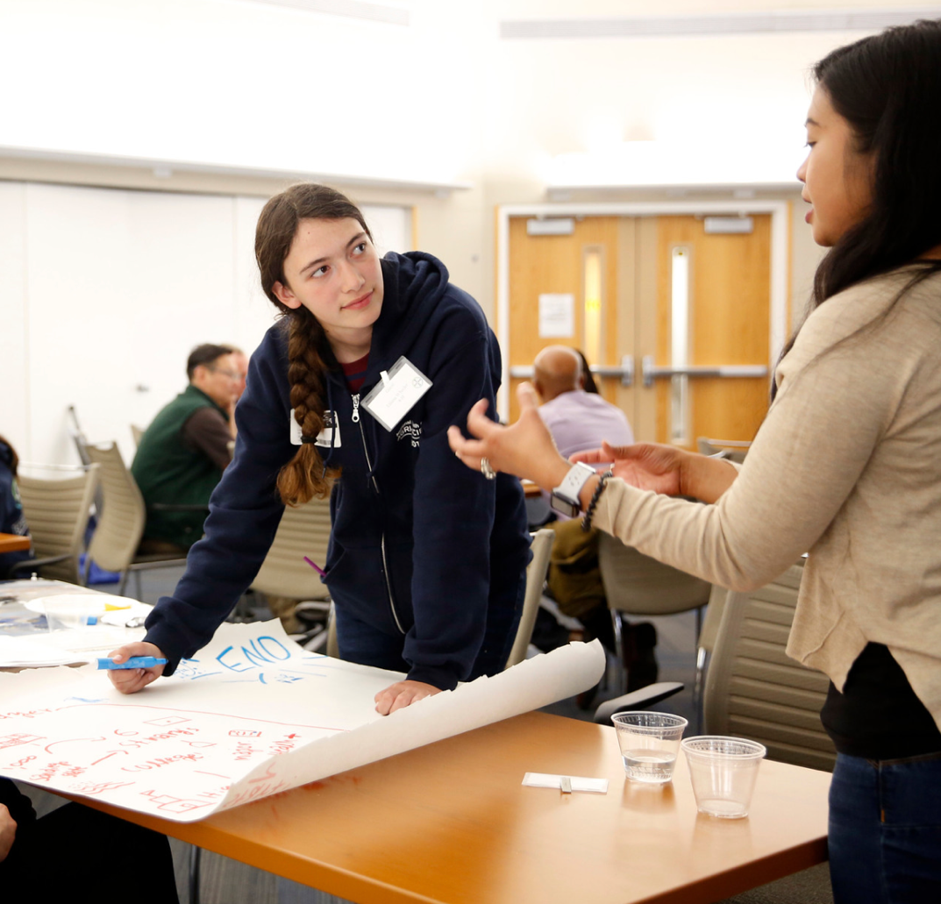
Importance & Benefits of Community Service
Instills a sense of responsibility and connection to something larger than themselves.
Opportunity to identify their purpose and to make a positive impact.
Skill development, including leadership, contribution, team-building, and collaboration.
Notes:
The Importance of Service to Community: The 4-H pledge emphasizes the commitment to service for one's club, community, country, and world. Engaging youth in community service projects instills a sense of responsibility and connection to something larger than themselves, enabling them to make a positive impact in the world.
Benefits of Community Service: Community service allows youth to practice skills that make them helpful citizens and fosters a sense of pride and ownership in their communities. It also helps them develop leadership and civic engagement skills, turning them into productive and contributing members of their communities.

Slide 39
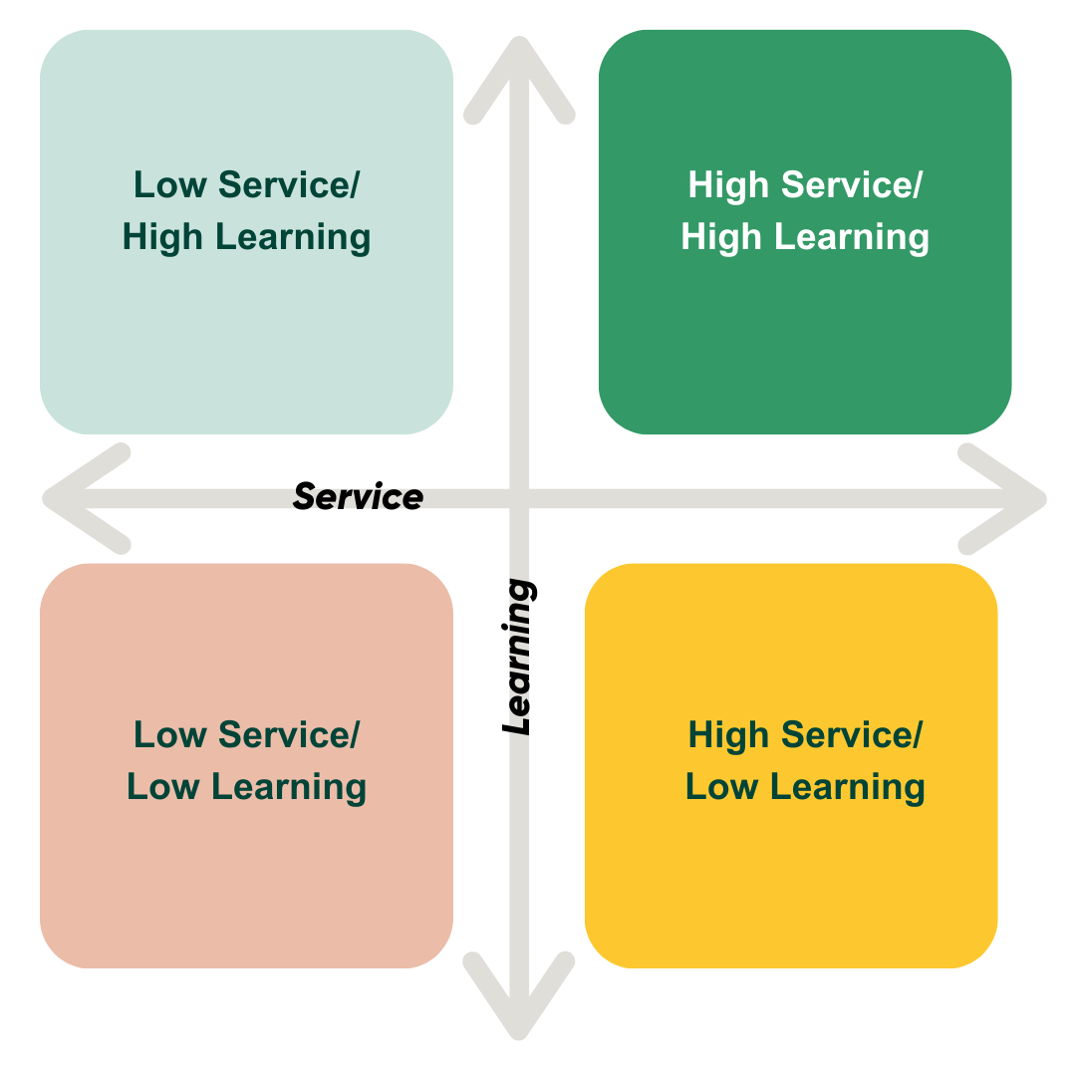
Community Service vs. Service Learning
Notes:
Community Service vs. Service Learning: Community service is often a one-way activity where youth provide a service without deeply considering the community's needs or learning objectives. Typically, community service activities fit in the 2 quadrants of with low learning. Low service and low learning or High Service and Low learning
In contrast, service learning combines learning and teaching objectives with community service to create a more enriching educational experience that connects youth to their community's needs and helps them share their knowledge. Service learning activities at their best are High Service and High Learning and could include Low Service and High Learning.

Slide 40
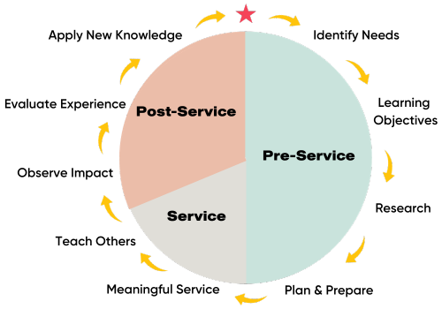
Service Learning Cycle
Notes:
Service Learning Cycle
The Service Learning Cycle consists of three stages: Pre-Service, Service, and Post-Service.
In the Pre-Service stage, youth identify community needs, establish learning objectives, and plan and prepare for their service project.
During the Service stage, they engage in meaningful service and observe the impact.
In the Post-Service stage, they evaluate their experience, explore how their new skills can be applied in other areas of their lives, and consider how to share their knowledge with others.

Slide 41
For more information, contact:
Your Name, Your Title
your-email@fourhcouncil.edu

Slide 42
Activity – Instruction Prompts
Service to the community–
Organizational Skills Domain

Slide 43
Activity: Service Grid Exercise
Review the high/low service-learning grid.
Using the scenario assigned to your small group, identify and record what the project would look like in each quadrant.
Share and discuss
Notes:
Activity Instructions
Service Grid Exercise
Introduce the high/low service-learning grid. (Handout 1)
Divide participants into small groups (2-4) people.
Distribute community service scenarios to small groups. Assign one scenario to each group.
Small groups identify and record what the project would look like in each quadrant on flip chart paper or a digital whiteboard for each group.
Ask each small group to share what they learned and how they adapted what it would look like in each quadrant.
Correct any misunderstandings.
Allow time for discussion and questions.
Author: Gemma Miner, University of California

Slide 44
Activity: Impact of Types of Service
In a small group, discuss the value of each type of service in the Service Learning Grid.
Share 1 – 2 ideas and examples with the full group.
3. Discuss how you can apply this information to your work in 4-H.
Notes:
Activity Instructions
Impact of Types of Service
If they are still in smaller groups from the previous activity--have them switch up to work with different people.
Ask participants to discuss the value of each section of the grid as a service opportunity for youth. (Handout 1)
In this activity we want to instill a “Do what you can” mindset.
Have each smaller group share the ideas for 1-2 types of service with the large group.
Be prepared to give examples for sections of the grid where participants may struggle to find examples.
What application questions can you use to help participants in each type of service learning develop a mindset of doing what they can depending on the venue, clientele, and other environmental factors.
Author: Stacey MacArthur, Utah State University

Slide 46
Marketing and Publicity
Organizational Skills Domain

Slide 47
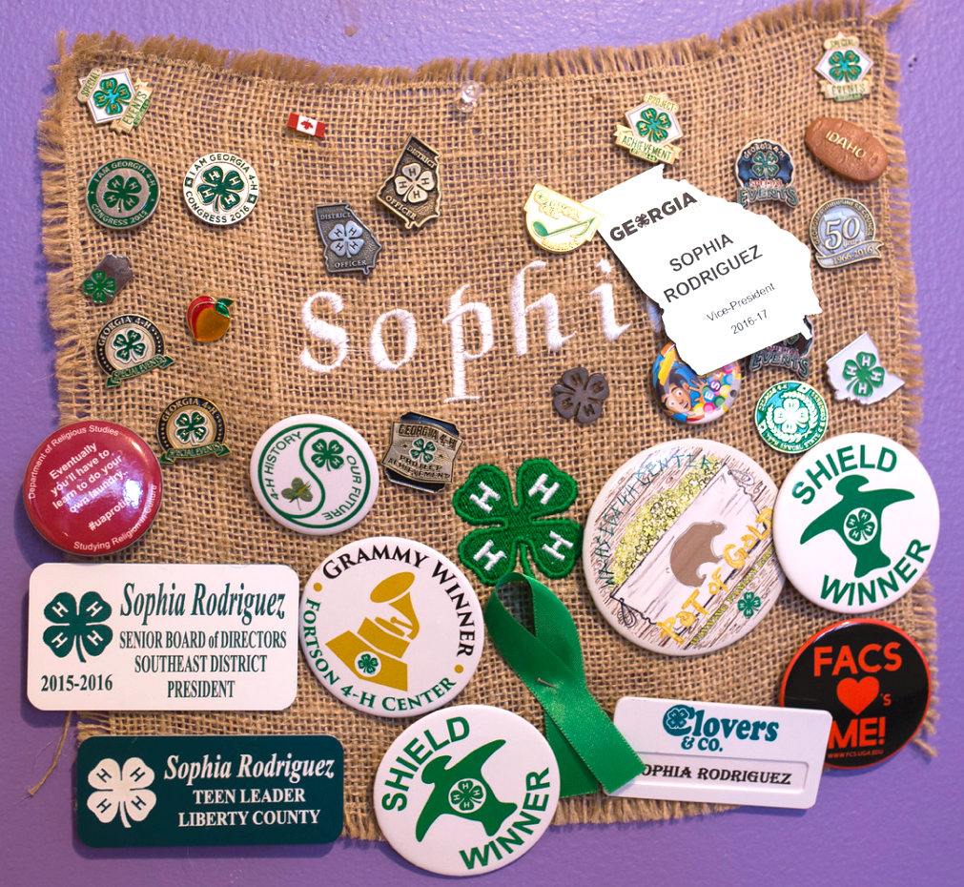
Develop the Message
Effectively communicate what 4-H is and what it is not.
Identify an issue, link the issue to opportunities provided by your 4-H group, and communicate to the community.
Invite new community members to your 4-H group.
Notes:
Effective Promotion Requires Interpretation of 4-H: Promoting a 4-H group successfully involves careful planning and organization. To effectively market 4-H, it's crucial to communicate what 4-H is and what it is not. This interpretation of the 4-H program is essential for reaching those outside the program.
Developing a Message: When crafting a promotional message, start by addressing a critical local or national issue and provide relevant statistics. Link this issue with opportunities offered by your 4-H group, showcasing how 4-H is making a positive impact. Acknowledge and give credit to those who contribute to the program. Then, broaden the message to describe the overall mission, purpose, and values of 4-H. Finally, invite the audience to get involved in your specific 4-H group.

Slide 48
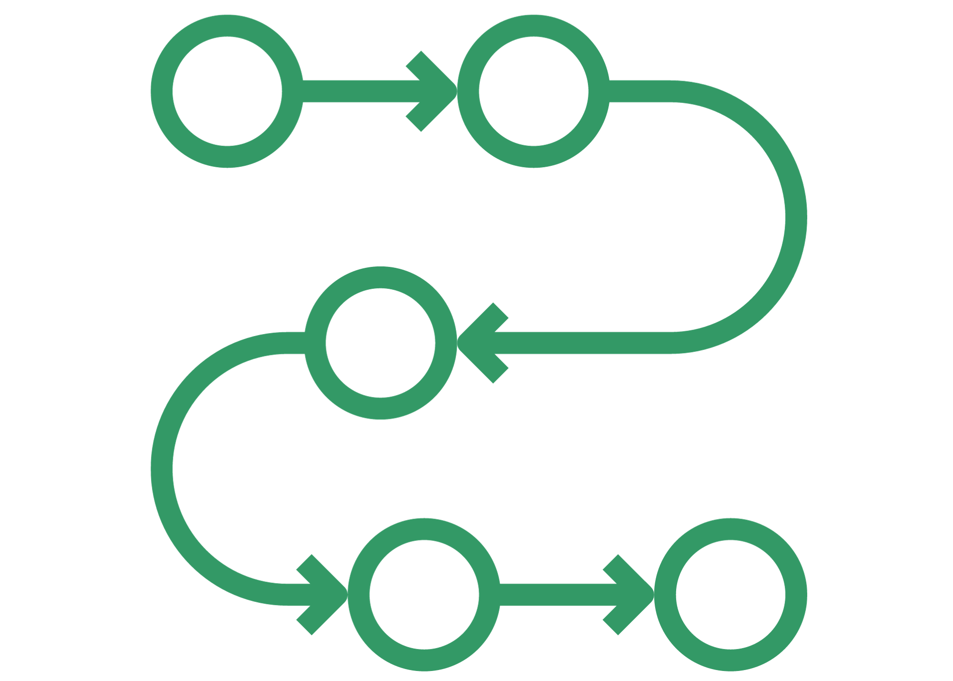
Develop a Strategic Plan
Set clear goals
Consider how to reach previously underrepresented community members in your program.
Define benchmarks to measure progress toward goals.
Be flexible and adjust the plan as needed.
Use multiple communication tools, flyers, social media, booth at community organization events, etc.
Notes:
Creating a Strategic Plan: A successful promotional plan is akin to a journey with four critical components: understanding the current marketing landscape, setting clear goals, establishing an actionable plan, and defining benchmarks to measure progress. The plan should be flexible to allow for adjustments when necessary.
Utilizing Tools and Strategies: Consider various tools and strategies such as brochures, flyers, digital communication, planned events, mass media (e.g., newspapers, radio, TV), and word-of-mouth marketing. Tailor your approach to the preferences of your target audience and maintain professionalism in all materials. Build relationships with media outlets to enhance your marketing efforts.

Slide 49

Social Media Best Practices
Choose content relevant to the audience.
Include photos.
Include a Call to Action: What do you want them to do?
Post 3-4 times per week.
Use relevant hashtags.
Do not use personally identifiable information in posts.
Notes:
Social Media Best Practices: When posting on social media, choose content relevant to your audience, include photos, and keep text concise. Incorporate hooks to generate interest and limit posting frequency to 3-4 times per week. Timing matters, so post during periods when your audience is most active. Use relevant hashtags, identify the post's location when applicable, and consider amplifying your posts through sponsored stories.

Slide 50
For more information, contact:
Your Name, Your Title
your-email@fourhcouncil.edu

Slide 51
Activity – Instruction Prompts
Marketing and publicity–
Organizational Skills Domain

Slide 52

Activity: Develop a Marketing Plan
Use the Marketing Plan Template to develop a plan for promoting a club, county, or statewide event.
Share with a partner or whole group for feedback to strengthen your plan.
Notes:
Activity Instructions
Developing a Marketing Plan
Use the Marketing Plan Template to develop a plan for promoting a club, county or statewide event.
Share with a partner or whole group for feedback to strengthen your plan.
Source: Strieter, L., (n.d.) Marketing and Publicity. VRKC: Volunteer Research, Knowledge, & Competency Taxonomy.

