Slide 1
Use of Ages and Stages to Create Developmentally Appropriate Programs
Educational Design and Delivery Domain

Slide 2
Working with 4-H “Cloverbuds” (Ages 5-8)
Social Development
Typical Behaviors | Implications for creating developmentally appropriate activities
● Tends to be self-centered, but starting to form a concept of “self” with individual efforts ● Learning to be a group member and to listen when others speak ● Learning about friendships and how to get along with others ● Want to be liked, especially by older youth and adults ● Beginning to learn to share (e.g., toys, adults, etc.) | Build in role-playing opportunities Limit activities to small groups that allow for peer and adult interactions Take time to recognize youth accomplishments Build in unstructured time or play time Keep activities cooperative that fosters sharing and encouragement
Adapted from Lee, F. & Go, C. (2002) and Marshall-Wheeler, N. and Miner, G. (2021).

Slide 3
Working with 4-H “Cloverbuds” (Ages 5-8)
Cognitive Development
Typical Behaviors | Implications for creating developmentally appropriate activities
● Typical attention span is about 20-30 minutes ● Interested in fairy tales and fantasy ● Learns best when s/he can be active while learning ● Does simple sorting and categorizing ● Learning about the value of money and how to make change ● Concerned about right and wrong ● Sees people like objects such as a boy or girl | Keep youth engaged As much as possible, plan for a “hands on” component in all activities where youth can physically manipulate to learn Plan for simple activities like identifying types of butterflies vs. types of insects - latter needs multilevel categorization Encourage youth to focus on the process rather than the final product. For example, what are some ways to make a knot vs. what is the right way to make a knot Foster exploration and inquiry by role modeling it
Adapted from Lee, F. & Go, C. (2002) and Marshall-Wheeler, N. and Miner, G. (2021).

Slide 4
Working with Junior 4-H’ers (Ages 9-11)
Social Development
Typical Behaviors | Implications for creating developmentally appropriate activities
● Learning about “self” competence through interactions with others – like completing 4-H projects to make parents happy ● Participates as a member of a group and contributes to the group effort ● Prefer same gender friendships of short duration, with youth moving from one group to another ● Acceptance by peer group is important ● Able to share – like the use of a tool while working together | “Set-up for success” – plan or adapt activities for every youth to be able to complete and feel competent Help youth identify “what they are good at” Focus accomplishments at the individual youth level (current vs. past accomplishments)- avoid comparing between youth. When working with mixed gender groups, provide opportunities for same gender activities Build-in or plan for opportunities where youth can recognize each other’s accomplishments
Adapted from Lee, F. & Go, C. (2002) and Marshall-Wheeler, N. and Miner, G. (2021).​

Slide 5
Working with Junior 4-H’ers (Ages 9-11)
Cognitive Development
Typical Behaviors | Implications for creating developmentally appropriate activities
● Longer attention span of about 40 minutes ● Likes to explore ideas especially if related to a hand-on or concrete experience ● Can do simple multi-tasking ● Learns best when new ideas are related to a previous idea and/or experience ● Understands that there is a reason for right and wrong and can apply it ● Able to develop part of a plan ● Gains understanding of exchange, give and take ● Interest expands from home to neighborhood and community ● People are seen as objects with thoughts, ideas, beliefs, and values | Continue to keep youth engaged by using different teaching methods Start your activities with the hands-on experience, keep instructions simple and brief Present a new idea or activity by referring to things that the youth already know When incidents occur, avoid telling the youth this is right or wrong, instead, ask why this could be right or wrong Engage youth in planning but set reasonable expectations Encourage youth to explore their neighborhood and community through a community service activity Invite youth to share their traditions, customs, values, etc.
Adapted from Lee, F. & Go, C. (2002) and Marshall-Wheeler, N. and Miner, G. (2021).​

Slide 6
Working with Junior and Senior 4-H’ers (Ages 12-18)
Social Development
Typical Behaviors | Implications for creating developmentally appropriate activities
● Developing their self-identity – discovering/ forming their own uniqueness, values, abilities, etc. ● Is self-conscious because of puberty and youth are now able to comprehend the concept of self-image ● Wants to make their own decisions – freedom from parental control ● Still likes to participate as a member of a group but now aware of and exploring the different roles in a group ● Seeks peer group acceptance like before, plus now, status matters ● Prefer same gender social groups, but this changes to mix gender groups especially in late adolescence (16-18 yrs.) ● Sees mutual benefits of sharing and working together. | Provide opportunities to share, learn and explore people’s different values, abilities, uniqueness, etc. so they can begin to identify their own Engage youth in healthy living discussions Give youth the opportunity to plan, implement and evaluate 4-H activities. Incorporate teamwork allowing for discussion of roles, for participants to try different roles. Foster a sense of belonging in which youth are accepted, encouraged and supported by their peers. Extend the teamwork discussion and encourage youth to talk about different roles and the status we attach to these roles. Provide opportunities for youth to create groups and decide which groups they want to be in Build-in or plan for opportunities where youth can recognize each other’s accomplishments
Adapted from Lee, F. & Go, C. (2002) and Marshall-Wheeler, N. and Miner, G. (2021).​

Slide 7
Working with Junior and Senior 4-H’ers (Ages 12-18)
Cognitive Development
Typical Behaviors | Implications for creating developmentally appropriate activities
● Enjoys exploring ideas and these can be abstract or virtual ● Challenges norms, questions what is right and wrong, reasons, etc. ● More complex understanding of exchange -like when it is beneficial ● Interest expands from home to country plus other countries ● Learns best when new ideas are linked to their interests ● Able to multitask ● Able to plan a whole event ● Beyond objects with thoughts and ideas, teens now understand that some of these thoughts and ideas are about them, making them self-conscious | Engage teens in current events that have a right and wrong aspect Use activities where teens explore world news, travel blogs, travel shows, etc. Engage teens in State and National 4-H activities, teams, projects, etc. Encourage teens to identify their interests, and further explore them Empower teens to be creative in how they lead and plan a wide range of activities Engage teens in exploring positive body image, self- esteem, identity, etc.
Adapted from Lee, F. & Go, C. (2002) and Marshall-Wheeler, N. and Miner, G. (2021).​

Slide 8



For more information, contact:
Your Name, Your Title
your-email@fourhcouncil.edu

Slide 9
Activity – Instruction Prompts
AGE AND STAGES & Developmentally Appropriate Programs –
Educational Design and Delivery Domain

Slide 10

Where Youth Are
Looking at Handout 1 and Handout 2, match up the behaviors described on the left with the age group on the right.
Looking at Handout 3 and Handout 4, share how you did. Did your responses match the answer key?
Notes:
Activity Instructions
Where Youth Are
This activity is meant to help individuals review and better understand expected typical behaviors with a youth’s age and stage.
1.) Distribute Handout 1 and 2.
2.) Ask participants to match up the behaviors described on the left with the age group on the right.
3.) Distribute Handout 3 and 4 which are the answer keys.
4.) Ask participants to share how they did? Did their responses match the answer key? If not, ask them to share why they thought differently?
5.) Remind the group that each youth grows physically, socially, and cognitively at their own pace and how they progress may vary from what is
typical.
6.) Refer back to the “Working With 4-H” factsheet tables as needed.

Slide 11
“So What” of Ages and Stages
On Handout 5 and Handout 6, read the implication.
Circle one or more of the age groups (Ages 5-8, Ages 9-11, or Ages 12-18) that the suggestion would apply to.
Review Handout 7 and Handout 8 and share how you did.
Notes:
Activity Instructions
“So What” of Ages and Stages
This activity is meant for participants to review the implications and decide if the suggested actions are applicable to one or more age groups.
1.) Distribute Handout 5 and 6.
2.) Ask participants to read the implication, and then circle one or more of the age groups (Ages 5-8, Ages 9-11, or Ages 12-18) that the suggestion would apply to.
3.) Distribute Handout 7 and 8 which are the answer keys.
4.) Ask participants to share how they did? Were there cases that did not match the answer key? Discuss as a group why the implication could be applicable to more
than one group.
5.) Refer back to the “Working With 4-H” factsheet tables as needed.
VRKC Fact Sheet Series provided by Draft: Mar, 2021
Program Leaders Working Group: 4-H Volunteerism Committee
Written by: Charles Go, Ph.D., University of California Agriculture and Natural Resources
References
Lee, F. and Go, C. (2002). Developmental stages. UC ANR 4-H Youth Development Program.
Marshall-Wheeler, N. and Miner, G. (2021). The UC 4-H Volunteer Educators’ Guide: For Volunteers Facilitating 4-H Projects and Other Educational Experiences. UC ANR 4-H Youth Development Program.
Pleskac, S. (2000). Educational design and delivery: Use of age-appropriate activities. VRKC.

Slide 13
Utilization of Multiple Teaching Strategies
Educational Design and Delivery Domain

Slide 14

Guiding youth as they learn new information
As a 4-H volunteer, the balance you seek to achieve a balance between a high enough level of difficulty to engage which is engaging and challenges the youth without creating too much frustration that results in the youth giving up.
Photo: National 4-H Council

Slide 15
Teaching Strategies
Spacing | Spread out learning over time
Interleaving | Switch between topics
Retrieval Practice | Bring information to mind from memory
Elaboration | Ask and explore how and why things work
Concrete Examples | Use specific tangible examples
Dual Coding | Combine words with visuals

Slide 16
For more information, contact:
Your Name, Your Title
your-email@fourhcouncil.edu

Slide 17
Activity – Instruction Prompts
Utilization of multiple teaching strategies–
Educational Design and Delivery Domain

Slide 18
Practicing Application
Pick a lesson from a 4-H curriculum unit.
Plan how you would teach this lesson in an after-school setting with a small group and with a large 4-H club.
Include one active learning strategy.
Notes:
Activity Instructions
Practicing Application
Put the cognitive learning strategies into practice. Pick a lesson from a 4-H curriculum piece that you can find at your local Extension office or online at https://shop4-h.org/ . Make a plan for how you would teach this lesson in an after-school setting with a small group and with a large 4-H club. In your plan choose one active learning strategy (https://teaching.berkeley.edu/active-learning-strategies ) which will help you intentionally target how youth learn. For example, using a “Think-Pair-Share” (from the link provided) would be a great way to try out the retrieval practice strategy. Would your plans be exactly the same for each situation? How could you tailor the actions to best fit the group and learning strategy targeted?

Slide 19
Planning Makes Things Easier
1. In your small group, create a plan for how you will
incorporate one learning strategy into your program
year plan.
2. Share your example plan.
Notes:
Activity Instructions
Planning Makes Things Easier
Success in inspiring deep long term learning takes planning and intentionality. Everyone has their own way they have learned to organize and plan. Use the knowledge of your group to find out what are the different ways in which people plan for their youth programming. Break the larger group into smaller discussion pods. If you have enough people, give each pod one of the learning strategies and ask them to create a plan for how they will incorporate that strategy into their program year plan. Each group can then report to the whole with the ideas they came up with and their chosen example plan.

Slide 21
Understanding Learning Mindset
Educational Design and Delivery Domain

Slide 22

Fixed Mindset
Individuals feel they are either good at something or they are not.
People in this mindset spend much of their time avoiding challenges and do not take feedback in a positive way.
Youth can be easily discouraged.
Photo: National 4-H Council

Slide 23

Growth Mindset
Individuals believe that their talents and abilities can improve over time with practice, diligence and guidance.
People look for opportunities to challenge themselves and they believe that feedback is a tool for growth.
Youth and adults are more motivated to learn, have better relationships, and are more resilient.
(Dweck, 2006)

Slide 24

Tips for encouraging growth mindset
Challenge them (but not too much!)
Build connections.
Provide meaningful feedback.

Slide 25
For more information, contact:
Your Name, Your Title
your-email@fourhcouncil.edu

Slide 26
Activity – Instruction Prompts
Understanding Learning Mindset–
Educational Design and delivery Domain

Slide 27
Spectrum Introspection (part 1)
Answer the six questions given to you to determine where you are on the mindset spectrum.
1. No matter how smart or skilled you are, there is always an opportunity to
Improve.
2. You can learn a lot of new things, but overall, you can’t improve your
intelligence level.
3. I enjoy situations that require me to think or work harder than normal.
4. I prefer situations where I don’t have to think or work too hard.
5. I prefer situations that challenge me, even if it means I will make mistakes.
6. I prefer situations where I can complete tasks without making mistakes.
Strongly Agree ​Agree ​Disagree​ Strongly Disagree
Notes:
Activity Instructions
Spectrum Introspection
Do you know where you are on the mindset spectrum? Before we can help youth thrive, we need to know whether we have a growth mindset or a fixed mindset.
Ask yourself the questions below and choose the following statement for each:
Strongly agree
Agree
Disagree
Strongly disagree
1. No matter how smart or skilled you are, there is always an opportunity to improve
2. You can learn a lot of new things, but overall, you can’t improve your intelligence level
3. I enjoy situations that require me to think or work harder than normal
4. I prefer situations where I don’t have to think or work too hard.
5. I prefer situations that challenge me, even if it means I will make mistakes
6. I prefer situations where I can complete tasks without making mistakes
If your answers to the odd numbered questions were mostly “agree” or “strongly agree” then you most likely have a growth mindset. If your answers to the even numbers questions were mostly “agree” or “strongly agree” then that indicates you may have a fixed mindset. If you had a mix of answers, then you are probably somewhere in the middle.
After answering the questions above, find a partner and share the following:
Where do you fall on the mindset spectrum?
Were you surprised about where you fall on the spectrum?
Are there areas where you would like to develop more of a growth mindset? If so, how might you go about it?
How might you use what you learned about yourself to help the youth that you serve?

Slide 28
Spectrum Introspection (part 2)
2. Find a partner and discuss the questions below about mindset spectrum.
Where do you fall on the mindset spectrum?
Were you surprised about where you fall on the spectrum?
Are there areas where you would like to develop more of a growth mindset?
If so, how might you go about it?
How might you use what you learned about yourself to help the
youth that you serve?
Notes:
Activity Instructions
Spectrum Introspection
Do you know where you are on the mindset spectrum? Before we can help youth thrive, we need to know whether we have a growth mindset or a fixed mindset.
Ask yourself the questions below and choose the following statement for each:
Strongly agree
Agree
Disagree
Strongly disagree
1. No matter how smart or skilled you are, there is always an opportunity to improve
2. You can learn a lot of new things, but overall, you can’t improve your intelligence level
3. I enjoy situations that require me to think or work harder than normal
4. I prefer situations where I don’t have to think or work too hard.
5. I prefer situations that challenge me, even if it means I will make mistakes
6. I prefer situations where I can complete tasks without making mistakes
If your answers to the odd numbered questions were mostly “agree” or “strongly agree” then you most likely have a growth mindset. If your answers to the even numbers questions were mostly “agree” or “strongly agree” then that indicates you may have a fixed mindset. If you had a mix of answers, then you are probably somewhere in the middle.
After answering the questions above, find a partner and share the following:
Where do you fall on the mindset spectrum?
Were you surprised about where you fall on the spectrum?
Are there areas where you would like to develop more of a growth mindset? If so, how might you go about it?
How might you use what you learned about yourself to help the youth that you serve?

Slide 29
Spectrum Scaffold
Think about a youth you know who has a fixed mindset about a subject or skill.
How might you structure experiences in 4-H to help that youth develop a growth mindset over time?
Share your approach with another volunteer (or the group) without naming the youth.
Notes:
Activity Instructions
Spectrum Scaffold
Think about a youth you know who has a fixed mindset about a subject or skill. How might you structure experiences in 4-H to help that youth develop a growth mindset over time? Share your approach with another volunteer (or the group) without naming the youth.

Slide 31
Knowledge of Subject Matter
Educational Design and Delivery Domain

Slide 32
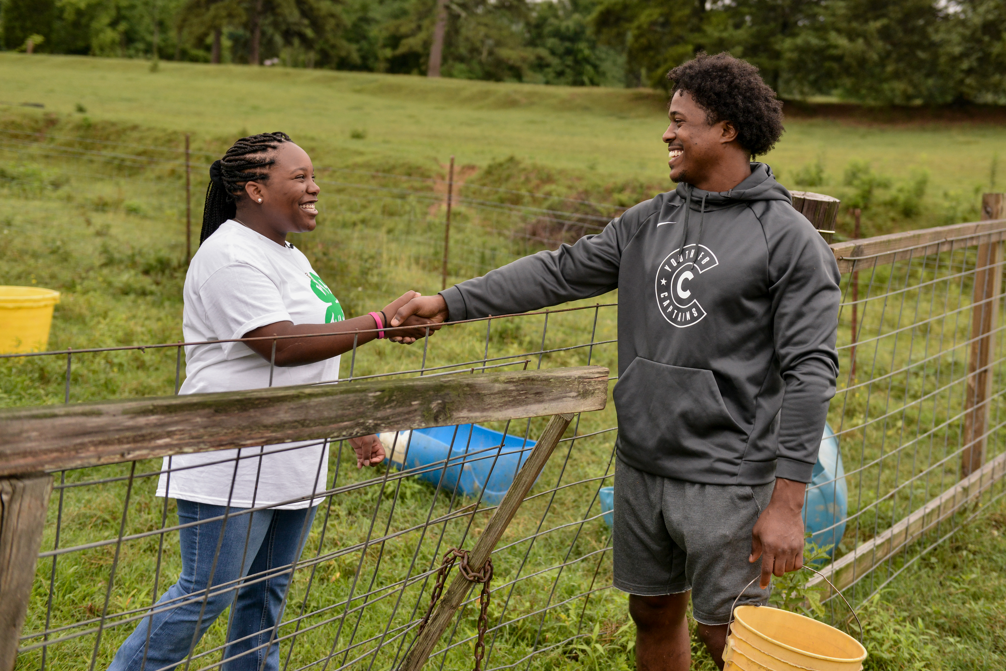
Volunteers with mastery of subject matter can:
help youth recognize how to approach subject matter accurately and guide a young person’s inquiry process.
be a resource to youth as they search for questions to investigate.
share networks of social and professional connections that can be accessed by youth to further their learning.
role model how adults form “social capital” in order to pool knowledge and resources.
Photo: National 4-H Council

Slide 33

Putting subject matter knowledge into practice:
inspires youth sparks
engages youth
Models process of learning how to learn
helps youth to develop life-long learning practices
Photo: National 4-H Council

Slide 34
For more information, contact:
Your Name, Your Title
your-email@fourhcouncil.edu

Slide 35
Activity – Instruction Prompts
Knowledge of Subject matter
educational Design and Delivery Domain

Slide 36
Mastery Discovery
Identify a subject that you are good at or teach as a 4-H volunteer.
Identify a 4-H resource (curriculum, handout, etc) that could be used to guide the teaching of this subject.
Outline what personal knowledge you will add to strengthen the lesson.
Notes:
Activity Instructions
Mastery Discovery
Have each person identify a subject they are good at or teach as a 4-H volunteer. This could be a project they provide leadership for. The next step could be done in groups or as individuals. Identify a 4-H resource (curriculum, handout, etc) they could use to guide the teaching of this subject. In the margin of the resource have the participants outline what personal knowledge they will add to strengthen the lesson. A real life story to make the content more real would be a good example. On flip paper record some of the ways volunteers used their own experiences and knowledge to plan for an exceptional learning experience.

Slide 37
Personal Learning Plan
Brainstorm and write out steps for a learning plan from a growth mindset.
Check in with your partner in a few weeks to see what progress has been made.
Notes:
Activity Instructions
Personal Learning Plan
Just like writing down goals helps them become a reality, writing out steps to a learning plan make it more real and likely to happen. Using the knowledge of your group, brainstorm different pieces individuals could include in their personal learning plan. To frame the discussion, introduce the idea of a fixed or growth mindset. Try to approach the development of your plan from a growth mindset where learning and success come through attitude and effort. As a final step pair the group up into accountability partners to check back in to see how progress has gone.
Questions to discuss with the group:
1. How do you determine what you want to learn - the learning goal?
2. How will you learn the new information - what is your strategy?
3. How will you know you were successful - how will you measure?
4. Who or what could help you - making connections and overcoming barriers?

Slide 39
Team Building Skills
Educational Design and Delivery Domain

Slide 40
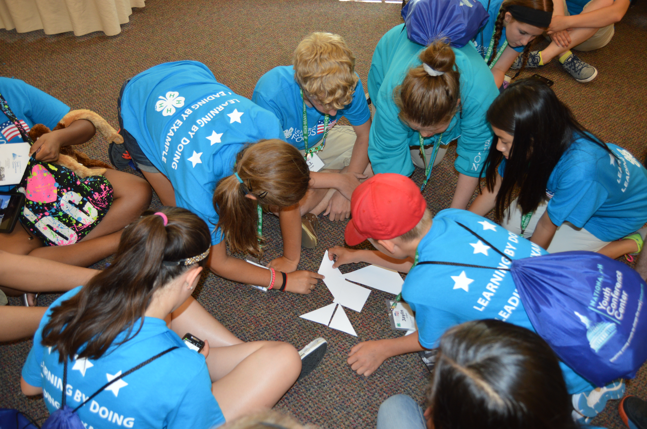
What is a team?
Shared goals
Members have perceived need for each other to achieve goal
Committed to idea that working together leads to better decisions
Group is accountable to shared goal, each other and organization
Photo: National 4-H Council

Slide 41

Why have teams?
Teams accomplish much more than individuals.
Teams are more creative.
Teams can garner more resources.
Teams create more synergy for the organization.
Teams are committed to results and accountability.

Slide 42
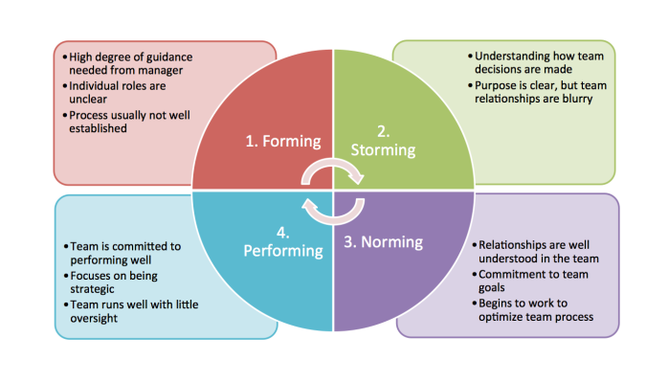
Forming-Storming-Norming-Performing
Image Source: Tuckman's Model - Forming, Storming, Norming, Performing

Slide 43
For more information, contact:
Your Name, Your Title
your-email@fourhcouncil.edu

Slide 44
Activity – Instruction Prompts
Team building skills–
Educational design and Delivery Domain

Slide 45
Group Norms
What does a well working team look like?
What ideas on the brainstormed list could be implemented within the group?
Notes:
Activity Instructions
Group Norms
Have a piece of large paper for everyone to see and a writing utensil.
Ask to group what a well working team looks like.
Record responses. (Examples: arrive on time, follow through on committee work, listen to others options, recognize whose voices are not at table and how to get other perspectives, youth’s voice, demographics etc.)
Ask what ideas on the brainstormed list that could be implemented within their group.
Post group norms at each meeting so they can be reviewed and adapted by the group.

Slide 46
Get Acquainted
The leader will call out, "Find someone with the same __________ and discuss __________".
For example-
Find someone with the same favorite color and discuss your favorite book.
Notes:
Activity Instructions
Get Acquainted
The leader calls out, “Find someone with the same (provide an example) and discuss (give another example). This activity gets people moving and discussing.
Examples—number of children or siblings, favorite color, size of hometown, color of cell phone or provider, etc.
Then discuss your favorite book, outdoor interests, fun things the committee could do, etc.
Source: Judy Levings, (2008). Educational Design and Delivery: Team Building Skills Lesson Plan. VRKC: Volunteer Research Knowledge Competency. 4-H.org

Slide 47
Introductions
Pretend you are hosting a party where no one knows anyone else. Walk up to one of your “guests” and introduce yourself by name.
For example:
  “Hi, I’m Karly. What’s your name? Gabrielle? Hi, Gabrielle, glad to meet you. Come on, there’s someone I want you to meet.” You then take Gabrielle to meet another “guest.”
2. Try to introduce everyone in three minutes.
Notes:
Activity Instructions
Introductions
Pretend you are hosting a party where no one knows anyone else. Have everyone standing in no particular order. In a party spirit, walk up to one of your “guests” and introduce yourself by name. For example:
“Hi, I’m Karly. What’s your name? Gabrielle? Hi, Gabrielle, glad to meet you. Come on, there’s someone I want you to meet.” You then take Gabrielle to meet another “guest.”
“Hi, what’s your name? Paul? Hi, Paul; this is Gabrielle. Gabrielle, this is Paul.” Gabrielle and Paul play it up. They smile, shake hands and say “Glad to meet you.”
Try to “introduce” everyone in three minutes.
Source: Chapin, Julie A. (2004) Volunteer and Club Development: Group-Building Ideas for 4-H Club and Group Meetings. https://www.canr.msu.edu/uploads/236/67551/4-HGroupBuildingIdeas2.pdf

Slide 48
A Pat on the Back
Draw an outline of your hand on a piece of paper and write your name across the top of the paper.
Pass the papers around the room.
Write down something positive about that person on their sheet.
Read what others have said about you.
Notes:
Activity Instructions
A Pat on the Back
Here’s an activity that can help members learn to notice positive qualities in others and communicate positive messages to them. And, it can help to improve an individual member’s self-esteem!
Each participant draws an outline of their hand on a piece of paper and writes their name across the top of the paper.
The papers are then passed around the room. Each member is asked to write down something positive about that person on their sheet.
After they have been around the room, the papers are returned to the leader. The leader should check the papers to be sure the comments are positive and appropriate.
Papers are given back to owners so they can read what others have said about them.
Source: McKinley, Steve (2018). 4-H Club Recreation and Team Building Activities. https://api.ag.purdue.edu/api/DepotWS/File.ashx?t=f&i=65263

Slide 50
Fostering Experiential Learning
Educational Design and Delivery Domain

Slide 51
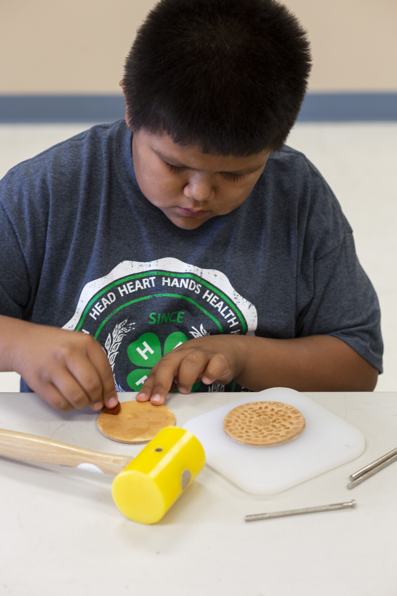
Fostering experiential learning can help youth to:
have a positive attitude towards the project
gain new knowledge and skills
be responsible for their own learning
improve youth’s decision-making skills
have confidence to share the knowledge they gained
Photo: National 4-H Council

Slide 52
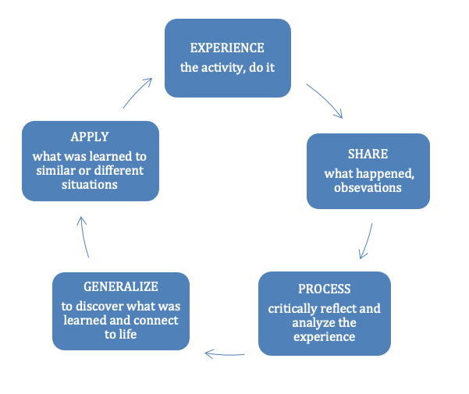
Experiential Learning Model
Moving Ahead: Preparing the Youth Development Professional (2000)

Slide 53
For more information, contact:
Your Name, Your Title
your-email@fourhcouncil.edu

Slide 54
Activity – Instruction Prompts
Fostering experiential learning–
Educational Design and delivery Domain

Slide 55
Asthma Attack
Wear a mask or a straw.
Breathe only through the mask or the straw.
Do a stationary run for 30-60 seconds.
Notes:
Activity Instructions
Asthma Attack
This activity is meant to help individuals better understand what happens when people who have shortness in breath (ex. Asthma attack) occurs for individuals.
Ask participants to get a mask or a straw. You can also provide them as part of a 4-H project kit.
Next ask them to breathe only through the mask or the straw.
Then have participants do a stationary run for 30-60 seconds.
Discuss using the Experiential Learning Model.
Experience – Do it
Share – Ask for their initial responses, observations, feelings… As relevant to the experience, you may want to ask youth, what did you smell, taste, hear, and/or touch? Share observations with the group and let the group acknowledge the ideas generated.
Process – Ask for the secondary response, or second thoughts about what happened? Are there things from your previous experiences and culture that could play a role in how you interpret the current experience? For example, youth who have experienced breathing difficulties or have had an asthma attack in the past may feel panicked or anxious. Did you notice any recurring response? Was there anything similar? Are there themes?
Generalize – Has there been a time when you were unable to participate due to a physical condition? Could you identify a “real life” principle from the themes? What did you learn about yourself through this activity?
Apply- Based on what you learned; how can you apply the knowledge to your life? What would you do differently? For example, when wearing a mask, be aware of breathing difficulties and reduce or slow down your physical activity to accommodate.

Slide 56
Mindful Eating- Fruit
Take three deep breaths before you begin to eat, counting each time you breath in and out.
Look at the fruit. What colors is it? What textures? What do you smell?
Notice your feelings. How do you feel about the fruit? Are you excited? Disappointed? Worried? Hungry?
Take a bite. What did you hear?
Before you swallow, keep the bite of fruit in your mouth for a few seconds. How does it taste? What does the fruit feel like? What are you feeling?
Think about the origins of the food. Where in the world did the food come from? Who was involved in growing, raising, or preparing it? How did it travel to you?
Notes:
Activity Instructions
Mindful Eating - Fruit
Each time you eat, you have the opportunity to eat mindfully. It does not matter if you are sitting down to a full dinner or just having a quick bite to eat. As you practice mindful eating, you can increase your enjoyment of food, make healthier choices, and recognize how much food you are eating.
Ask or provide participants with a fruit.
Tell them to take three deep breaths before you begin to eat, counting each time you breath in and out.
Look at the fruit. What colors is it? What textures? What do you smell?
Notice your feelings. How do you feel about the fruit? Are you excited? Disappointed? Worried? Hungry?
Take a bite. What did you hear?
Before you swallow, keep the bite of fruit in your mouth for a few seconds. How does it taste? What does the fruit feel like? What are you feeling?
Think about the origins of the food. Where in the world did the food come from? Who was involved in growing, raising, or preparing it? How did it travel to you?
Discuss using the Experiential Learning Model.
Experience – Do it
Share – Thinking of your five senses (sight, smell, sound, touch and taste), what happened? Ask for the initial response
Process – Ask for the secondary response, or second thoughts about what happened? Did you notice any recurring response? Was there anything similar?
Generalize – Could you identify a “real life” principle from the themes? What did you learn about yourself through this activity?
Apply- Based on what you learned, how can you apply the knowledge to your life? What would you do differently?

Slide 58
Program Evaluation Methods
Educational Design and Delivery Domain

Slide 59
Continuous Improvement
Continuous improvement is using information (such as data, observation, or self-reflection) to improve efficiency and effectiveness of an educational program or initiative.
(Clark et al., 2013)
4-H Motto- “Make the best better”

Slide 60
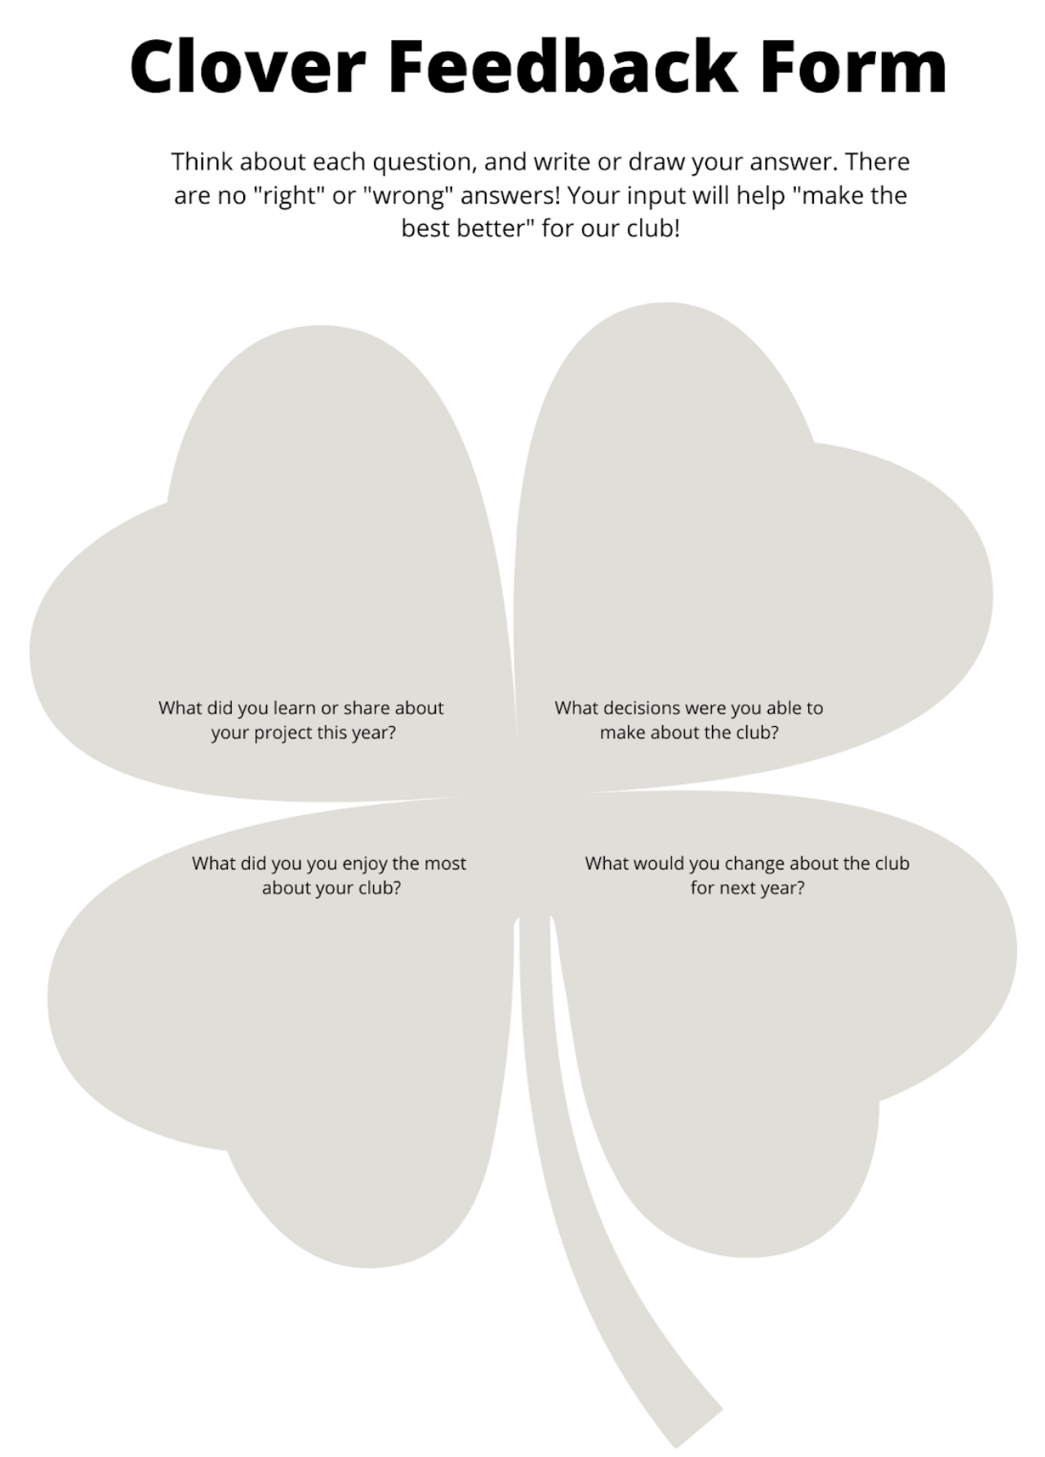
Participant Feedback
Keep it simple.
You can solicit feedback from youth, parents or even other volunteers.
Use the Clover Feedback Form.

Slide 61

Facilitator Self-Reflection
Is my reason for being a 4-H leader the same now as it was when I started?
Do I make myself accessible to my members, parents and other volunteers?
Do I seek input or feedback from my members and parents?
If I were a 4-H member, how might I rate myself?
Is my club/program vibrant? If not, why not?

Slide 62
For more information, contact:
Your Name, Your Title
your-email@fourhcouncil.edu

Slide 63
Activity – Instruction Prompts
Program Evaluation methods–
Educational Design and Delivery Domain

Slide 64
Pair Share
Find a partner.
Take turns asking each other the leadership self-reflection questions listed in the fact sheet.
    What surprised you about your answers?
    Are there any areas you think you can improve?
    How might you “make the best better” as a club leader for your club or program?
Notes:
Activity Instructions
Self-reflection Pair Share
Find a partner and take turns asking each other the leadership self-reflection questions listed in the fact sheet. What surprised you about your answers? Are there any areas you think you can improve? How might you “make the best better” as a club leader for your club or program?

Slide 65
4-H Quality Check-up
Partner with another volunteer to observe each other’s 4-H club or activity.
Give your partner a copy of the 4-H Quality Checklist. Ask them to identify which characteristics of positive youth development are happening during the meeting or event.
Reflect on the results. Which characteristics were present during your meeting? Which ones are opportunities for improvement?
Notes:
Activity Instructions
4-H Quality Check-up
Partner with another volunteer to observe each other’s 4-H club or activity; give your partner a copy of the 4-H Quality Checklist. Ask them to identify which characteristics of positive youth development are happening during the meeting or event. Afterwards, reflect on the results. Which characteristics were present during your meeting? Which ones are opportunities for improvement? It might be helpful to discuss the results with your local 4-H professional to get help with strategies for any areas you may be struggling with.

