Slide 1
Developing Life Skills
Positive Youth Development Domain

Slide 2
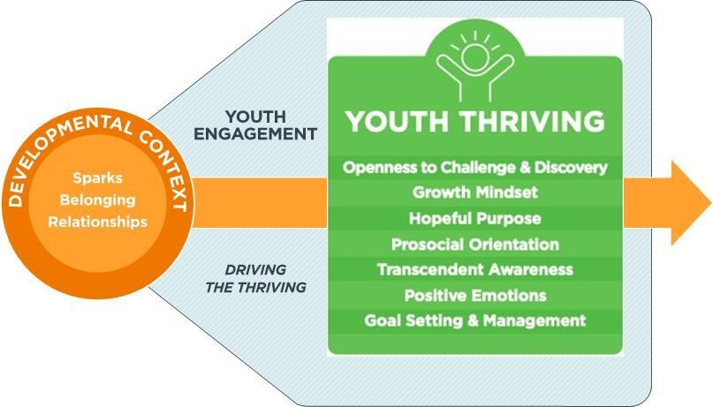
Components of a Thriving Trajectory

Slide 3
Volunteers help youth develop these critical life skills by:
encouraging youth to try challenging things
developing project activities and lessons that are progressive and sequential
cultivating a growth mindset
increasing a sense of hope and purpose
modeling moral behaviors
facilitating activities to create sense of belonging
encouraging youth to observe and remember behaviors that are rewarded.
modeling positive ways to express emotions by labeling and acknowledging.
teaching youth how to set a goal and develop strategies to reach it.

Slide 4



For more information, contact:
Your Name, Your Title
your-email@fourhcouncil.edu

Slide 5
Activities
Developing Life Skills– Positive youth Development Domain

Slide 6

How Can You?
Work in pairs to complete the How Can You? Handout.
Share ideas.
Reflect and discuss best practices to help youth develop life skills.
Notes:
Activity Instructions
How Can You…?
1.) Distribute the How Can You...? Handout and the Tip Sheets on the thriving indicators.
2.) Ask participants to work in pairs to complete the How Can You…? Handout.
3.) Bring the full group back together and share ideas from each pair.
4.) Reflect and discuss best practices for volunteers to help youth develop life skills.

Slide 8
Leadership Skills
Positive Youth Development Domain

Slide 9
Six ways youth can share their voice
Advising Involvement in decision-making at all levels.
Advocating Select a community issue of importance and make
a plan to improve that specific situation in the
community.
Mentoring Encourage others to grow as a person and as a
4-H’er.
Planning Improve 4-H by working with others to carry out
events.
Promoting Present a positive image of 4-H in the community.
Teaching Lead workshops or lessons on a specific subject
(team or individual choice).

Slide 10
Teaching essential skills for leadership
Leadership Basics | style, self-regulation goals, resilience
Relationship Building | Trust, accountability, interpersonal skills, diversity
Communication | listening, public speaking, boy language, conflict management
Organization | planning, time management, brainstorming, critical thinking
Group process | Working with others, problem solving, decision making, facilitation
Career readiness | work ethic, accountability, interviewing, technical skills

Slide 11
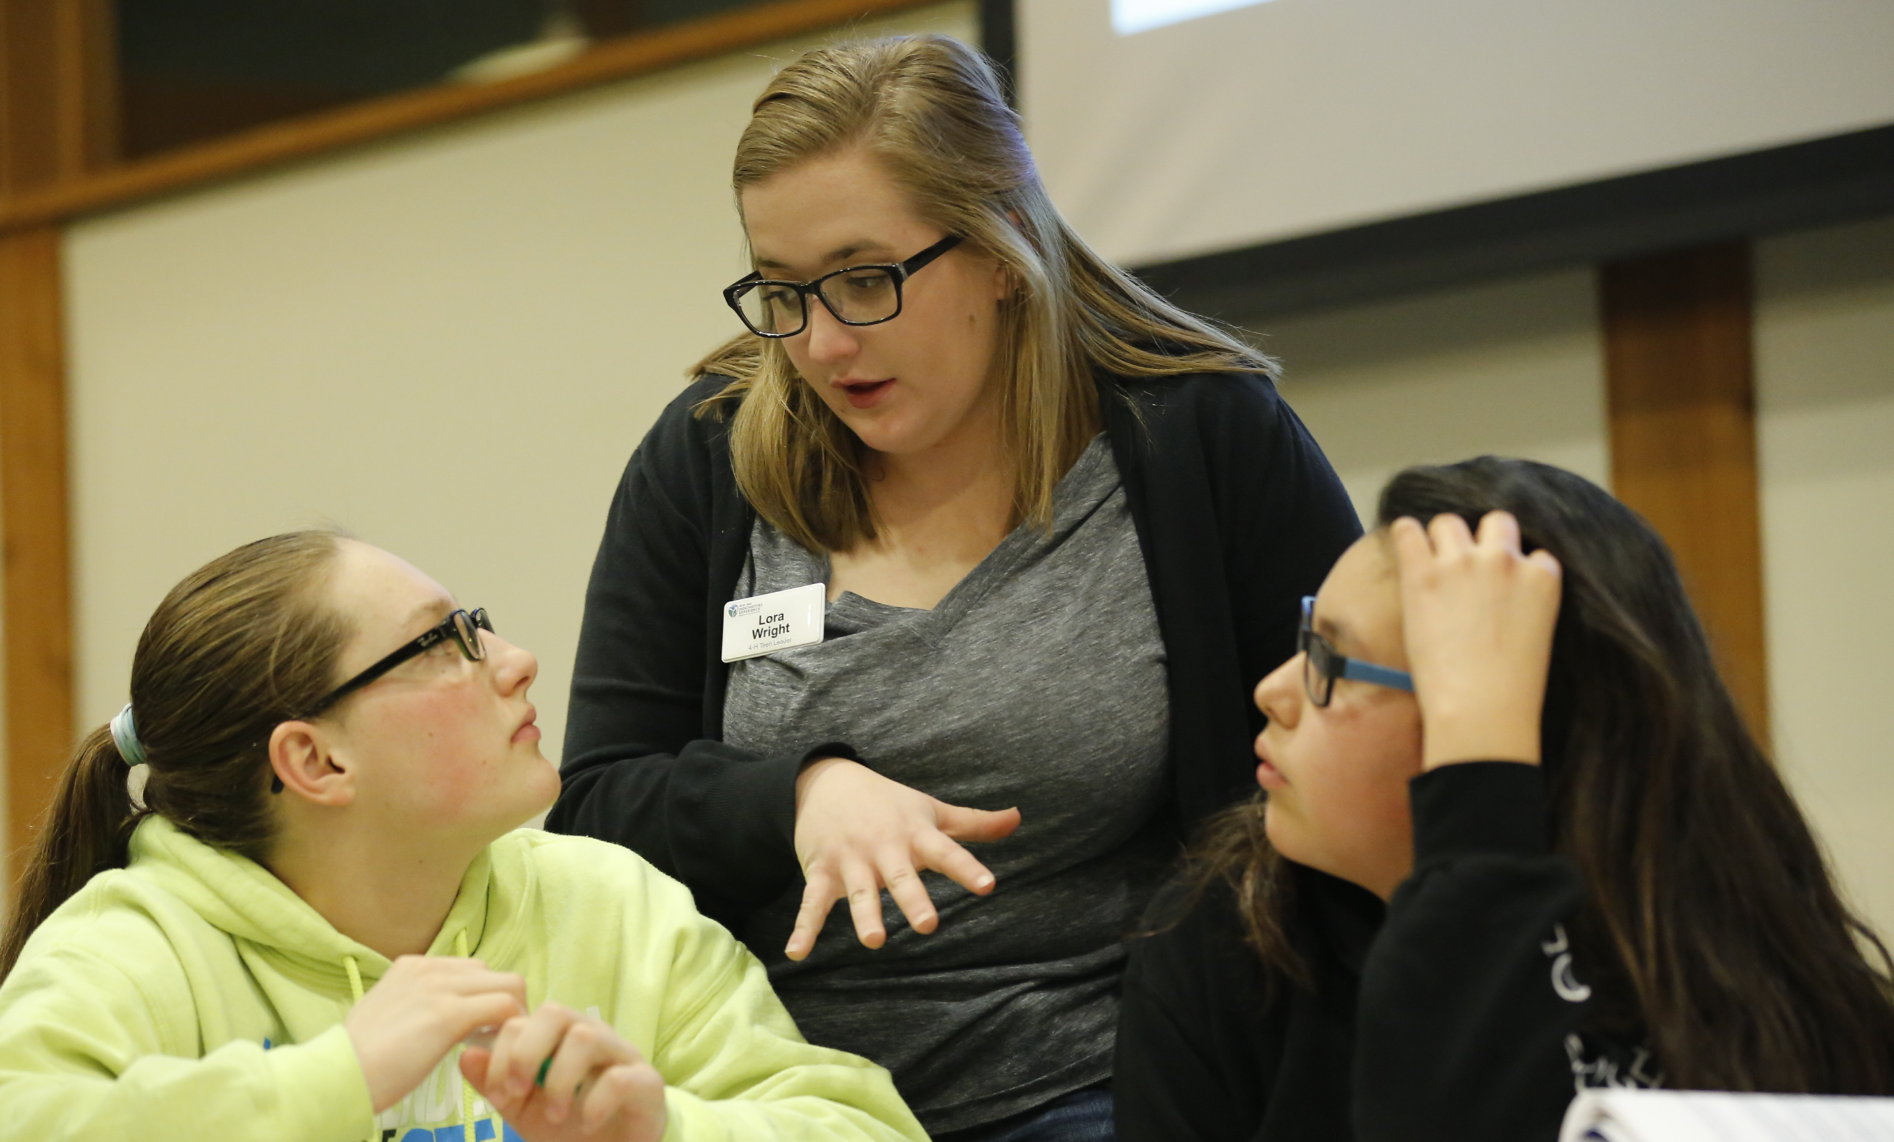
Adults can encourage teen leadership by
Engaging in frequent contact
Providing opportunities to belong
Avoiding tokenism
Involving youth from beginning to end
Providing appropriate levels of challenge
Sharing ideas but don't overshadow
Offering specialized training
Offering self-assessments and debriefings
Seeking out educational opportunities for your own leadership skill development

Slide 12
For more information, contact:
Your Name, Your Title
your-email@fourhcouncil.edu

Slide 13
Activities
Leadership Skills–
Positive youth Development Domain

Slide 14
Apple Analogy
Work individually on the Apple Analogy Handout and complete as many items as you can.
Pair and share lists with one other person. Concentrate on developing a list of skills necessary for each of the roles.
Join two pairs into a quad and reflect together.
Notes:
Activity Instructions
Apple Analogy
Ask participants to work individually for five minutes on the Apple Analogy Handout and complete as many items as they can.
Pair and share lists with one other person for five minutes. Concentrate on developing a list of skills necessary for each of the roles.
Join two pairs into a quad to reflect together.
Bring the full group back together and discuss:
For leadership, which competency/leadership roles do we offer in our county or state? How can we add/create more variety? Variety in teen leadership roles is important. A youth that likes planning may not like speaking.
What roles need improvement/or could be strengthened in your specific learning environment? For example, club president, project helper, county ambassador or camp counselor?
What can you do to encourage kids to participate in leadership roles?

Slide 15
Adult Leadership Self-Assessment
Take three minutes to complete the self-assessment.
Which skills did you rank at a level 4 or 5?
Choose three skills, put each on a sticky note with your name. Place your sticky note under the corresponding youth program quality feature/training topic the action represents. Do the same for the 1 or 2 levels.
Write down a short-term skill goal and a long-term skill goal.
Notes:
Activity Instructions
Adult Leadership Self-Assessment
Distribute a self assessment and sticky notes to each participant. On a white board write down either the eight 4-H Youth Program Quality Principles or the six general training areas listed in the Leadership Fact Sheet.
Explain a self-assessment is a process of discovery, an opportunity to reflect, set goals and take action. Take 3 minutes to honestly complete the self-assessment.
Share with the group that the same leadership skill can be easy for some and difficult for others. How many skills are you at level 4 or 5? How many skills are you at level 1 or 2? Does a good leader need to have all 4’s and 5’s?
Ask each participant to share the skills they ranked themselves at a level 4 or 5 (competent) on a sticky note. One skill per sticky note. Suggest they write at least 3 skills and list their name. They should place their sticky note under the corresponding youth program quality feature/training topic the action represents. Have participants note where they rate themselves at a 1 or 2 (beginner level). Repeat the process with the sticky notes.
In a large group, reflect and debrief the activity to reinforce that successful leaders draw on others strengths and expertise while offering their own. Leaders embrace their strengths and use them often. Everyone has room for improvement, even with skills they are good at. Additional reflection points:
Share an example of how you demonstrate a particular skill on the assessment.
Based on the placement of the sticky notes, what training does the group need to become stronger role models?
Are there people in the room who excel at a skill others would like to improve? How can we work together to help one another grow?
Suggest participants write down a short term skill goal (3 months) and a long term skill goal (1 year), and share them with the educator.

Slide 16
Glued to a Stick
  Form two lines, shoulder to shoulder, facing each other. Hold an 8-foot dowel between the two lines at shoulder height. Hold out an index finger and balance the dowel on their fingers.
  Lower the stick to the ground keeping all fingers “glued” to the stick - without anyone’s finger losing contact.
  If contact is lost, your group should stand back up and try again.
Notes:
Activity Instructions
Glued to a Stick
Divide participants into two equal groups. Set up the teamwork activity as follows:
Each group should form two lines, shoulder to shoulder, facing each other. Hold an 8-foot dowel between the two lines at shoulder height. Each participant then holds out an index finger. They must balance the dowel on their fingers.
Once they have balanced the stick, observe to make sure that each person’s finder is in contact with the stick. Then explain that their task is to lower the stick to the ground keeping all fingers “glued” to the stick - without anyone’s finger losing contact.
If contact is lost, the group stands back up and tries again from shoulder height. The facilitator, positioned at the end of the line, watches the group for adherence to the contact rule. This activity is more difficult than it sounds!
Spend 5 - 10 minutes on the activity.
This activity can be used for leadership training with teens. Have the group discuss key features for teen leadership programs and if this activity fits some of those elements. Possible discussion topics include:
Is this activity safe, motivating, fun, and give youth the opportunity to build relationships? How well did your group work together?
Did this activity have a developmentally appropriate level of challenge? What made this activity hard to do? What did you do to overcome this challenge?
How many times were needed until the group was successful? Success doesn’t necessarily mean getting the stick to the ground. Is it possible for the group to feel successful even when the end result is less than perfect? There are many key features for a successful leadership program, and one item could be respect.
Did this activity allow for different ideas, strategies, or ways of thinking? Did you overshadow other participants' ideas with your own? How did it feel when your strategy wasn’t implemented or listened to? Adults need to provide support, and be willing to listen, encourage and assist.
What role did you play on the team? Did you have good ideas, but were afraid to share? Every person plays an important role in how well the group functions. All voices should be heard, and an adult mentor should play the supportive role.
Activity adapted from Youth Advocates for Health, National Curriculum, Arnold, M.E. & Gifford, L. N. (Edsl). 2014, and Step Up to Leadership Mentor Guide for Grades 6-12,National Curriculum, The Team Work Tightrope.

Slide 18
Understanding How Youth Develop
Positive Youth Development Domain

Slide 19

the science of individuality (Rose, 2015)
Jaggedness is the idea that if we plot the growth points for one individual, those points will not line up nicely on the average line for anyone. If you plot multiple people, we can see that if we serve the “average” we serve no one.

Slide 20
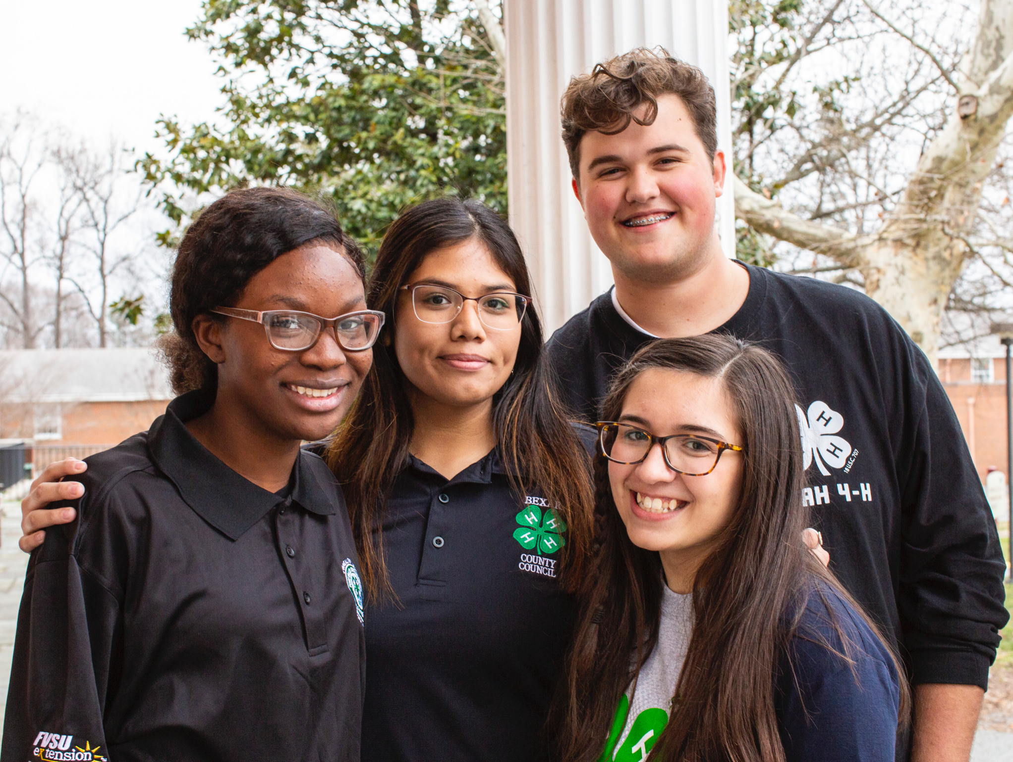
the science of individuality (Rose, 2015)
Context matters. Traits are a myth. We should see behaviors and ways of being in context. For example, IF Jose is at a 4-H project, THEN he is self-conscious. However, IF Jose is at school, THEN he is confident.

Slide 21

the science of individuality (Rose, 2015)
Pathways suggest there is not a single, “normal” pathway for any type of human development— biological, mental, moral, or professional. There are many equally valid ways to reach the same outcome and what works for you depends on your individuality.

Slide 22

Ways to support individual growth strategies
Youth goal setting.
Inquiry-based questions.
Active listening.
Watch closely.
Youth as an educator.

Slide 23

Practices to avoid that can hinder individual growth
  Normalizing some traits and skills, and not others.
  Setting group agreements or expectations that not all youth can agree to.
  Labeling youth.
  Insisting on only one “right” way to learn something.

Slide 24
For more information, contact:
Your Name, Your Title
your-email@fourhcouncil.edu

Slide 25
Activities
Understanding How youth Develop
Positive youth Development Domain

Slide 26
We Are All Jagged
Work individually to rate yourself on the line in response to each prompt on the Skills Worksheet.
In groups, graph everyone's points on one of the How Jagged is Your Group Worksheet.
To show each person, draw a line that connects the dots for that person so that the chart will have multiple jagged edges.
Analyze the final data on the Plot Worksheet.
Notes:
Activity Instructions
We Are All Jagged
1.) Handout the Skills Worksheet to everyone.
2.) Ask each participant to work individually for about five minutes to rate themselves on the line in response to each prompt.
3.) In groups of 5-8 people, handout How Jagged is Your Group Worksheet and ask them to graph everyone’s points on the one sheet of paper, to show each person, draw a line that
connects the dots for that person so that the chart will have multiple jagged edges. (Or if a small group, ask everyone to plot their points on a flip chart for all to see.)
4.) Ask the group to analyze the final data on the Plot Worksheet.
5.) Bring the full group back together and debrief the activity to reinforce the concept of “jaggedness”.
Virtual Adaptation: develop a slide or two of the plot worksheet and use the annotate feature for each item.

Slide 27
My Traits Are Not Your Traits
Hold up five fingers.
The person born closest to January 1st goes first.
They will share one true statement about one of their traits that is true in one setting, but not another. Frame the statement as an “If….then” statement. For example, “If I am in a crowded room, then I am very quiet.”
Anyone that the statement is also true for gets to keep their fingers up, while anyone that the statement is not true for, puts one finger down.
Play until everyone that wants to, has had one chance to share a true statement.
Notes:
Activity Instructions
My Traits Are Not Your Traits
1.) In groups of 5-8 people, all participants hold up five fingers.
2.) The person born closest to January 1st goes first and shares one true statement about one of their traits that is true in one setting, but not another. Frame the statement as an “If….then” statement. For example, “If I am in a crowded room, then I am very quiet.”
3.) Anyone that the statement is also true for gets to keep their fingers up, while anyone that the statement is not true for, puts one finger down.
4.) Play until everyone that wants to, has had one chance to share a true statement.
5.) Bring the full group back together and debrief the activity to reinforce the concept of “content matters”.

Slide 28
The Road Less Traveled
In groups, create a list of the challenges you have when developing lesson plans for a group of youth.
Create a list of strategies to overcome those challenges. Consider multiple pathways of learning to overcome those challenges.
Notes:
Activity Instructions
The Road Less Traveled
1.) In groups of 3-4 people, for 10 minutes, create a list of the challenges you have as 4-H educators when developing lesson plans for a group of youth.
2.) For 20 minutes, create a list of strategies to overcome those challenges. Consider multiple pathways of learning to overcome those challenges.
3.) Bring the full group back together and debrief the activity to reinforce the concept of “pathways”.

Slide 30
Empowerment of Others
Positive Youth Development Domain

Slide 31
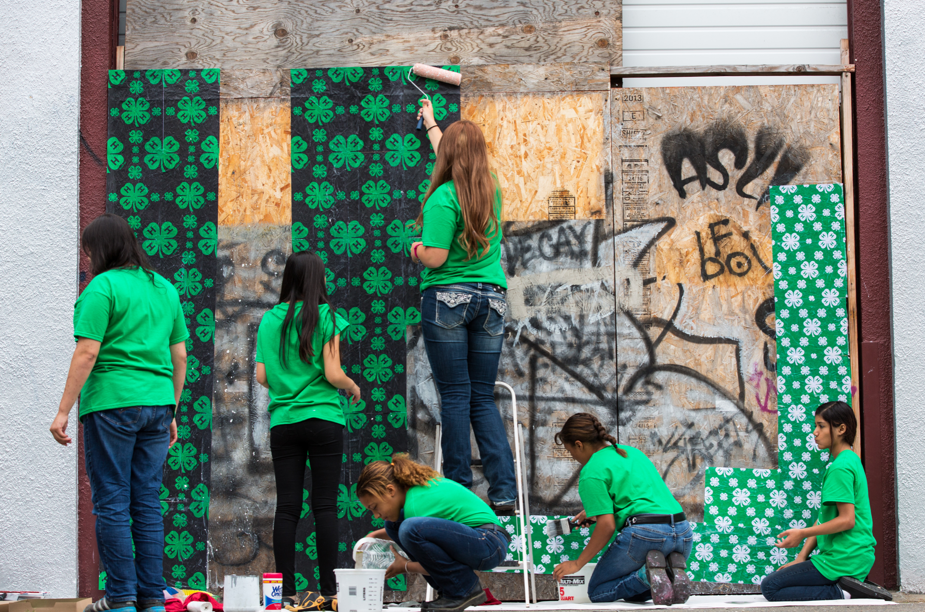
external assets supporting youth empowerment
  Community values youth - young people feel valued and appreciated by adults.
  Youth as resources - young people contribute to decisions and are given useful roles in the community.
  Service to others - young people have opportunities to help others in the community.
  Safety - young people feel safe at home, at school, and in the neighborhood.

Slide 32
Volunteers should try to provide:
  Several opportunities to make choices or decisions
  Continuous opportunities to ask questions
  Acknowledgement of youth’s ideas
  A commitment to try the children’s ideas and work as a team
  Allowance for autonomy and shared responsibility

Slide 33
For more information, contact:
Your Name, Your Title
your-email@fourhcouncil.edu

Slide 34
Activities
Empowerment of others
Positive youth Development Domain

Slide 35
Balloon Community
Blow up balloons, ¾ full. Write your name and the role/trait they most align with.
Collect and spread balloons out over a large space.
Give everyone 5 - 10 seconds to find a balloon, not their own.
Deliver balloon to the correct person. Share with the person why the role/trait they listed is helpful when either serving on a committee or as a member of the community.
As a group, discuss how each of the six common roles found in a teamwork environment can benefit our community/committees.
Notes:
Activity Instructions
Balloon Community
Have all participants blow up their balloons, ¾ full. Everyone should write their name and the role/trait they most align with from the following list: energizing and social, thoughtful & engaged, attention to detail, helper/hard worker, leader/take charge, skeptic or critical.
Collect all the balloons in a large garbage bag and spread them out over a large space.
Give everyone 5 - 10 seconds to find their own balloon. (How much time you allow depends on how many balloons you have. You do not want participants to find their own balloons.)
When time is up, have participants pick up a balloon closest to them and have them deliver it to the correct person. Take 10 -15 seconds to share with the person why the role/trait listed on the balloon is helpful when either serving on a committee or as a member of the community.
Explain to the group that when we only focus on ourselves, it can take a lot longer to discover how we fit into the community. But when someone else acknowledges our strengths or a role we can play, then we feel valued and connected. Youth empowerment happens when the young person perceives that adults in the community value the youth.
As a group, discuss how each of the 6 common roles found in a teamwork environment can benefit our community/committees - energizing and social, thoughtful & engaged, attention to detail, helper/hard worker, leader/take charge, skeptic or critical. Optional: What are the strengths or potential problems when youth take on these roles when working with adults?

Slide 36
Thriving Communities Brainstorm
In your small group brainstorm what factors contribute to a thriving community. Write individual ideas on sticky notes.
Look at the ideas you generated and divide them into the six categories you see on the wall.
Discuss the following:
  Do you see any themes?
  What do you think would help address the issues in your community?
  Where can youth help and serve in their community?
  What role can they have?
Notes:
Activity Instructions
Thriving Communities Brainstorm
This activity gets participants thinking about what makes a community vibrant and healthy. On the center of the paper or a white board, write “Thriving Community” in large letters. Explain a community can be your family, school, neighborhood, town or city.
Divide participants into groups of 4 to 5. Begin by asking people to think about what factors contribute to a thriving community. Tell them that to thrive means to grow or develop vigorously, to flourish. What kinds of things do communities need to flourish?
Ask participants to brainstorm together in their small groups and write down as many ideas as they can in five minutes. They should write each idea on an individual sticky note.
While they are working, the facilitator should write the following subsections around the words “Thriving Community” on the wall: Environment, Social Networks/Culture, Jobs/Educational Opportunities, Food, Healthcare, and Other.
After 5 minutes, ask them to stop. Now, they should look at the ideas they generated and divide them into the six categories they see on the wall. Have one or two people from each group come forward and place their sticky notes in these six categories.
After each group has posted its sticky notes, survey and discuss the range of ideas that people posted on the wall. Do you see any themes? What do you think would help address the issues in your community? Where can youth help and serve in their community? What role can they have? Youth empowerment begins when a youth is given a useful role in their community and commits their time to help on a consistent basis.
The Power of Nonverbal
Ask individuals to work in pairs. One person in the pair will be the designated speaker and the other person will communicate with nonverbal cues only.
Challenge: The speaker will continue talking (about any subject) regardless of the cues the other person is giving to 2 minutes. The non-speaker will roll a dice to determine what message they will be giving off with nonverbal cues. (If the facilitator wants to keep the adjectives secret from the speaker, they can simply whisper the desired cue or have pre-labeled pieces of paper.)
Engaged - Super interested in what the speaker is saying!
Apathetic - Not interested one bit.
Angry - Very opposed to what the speaker is saying.
Distracted - Interested in speaker, but really need to go to the bathroom.
Distracted - Not very interested; anxiously waiting for a call, text, or email.
Tired - Exhausted and having difficulty concentrating.
After 2 minutes, have the speaker try to guess what nonverbal cue was communicated.
Switch roles and repeat for 2 additional minutes.
Discuss and reflect on the impact nonverbal cues have on the speaker
Share roles and dynamics of the interaction (E.g., Continuing to speak when someone is clearly not interested is very difficult. The speaker can generally figure out what message the nonverbal communication is saying.)
Written by: T. Ashley Burns, Clemson University

Slide 37
Subtle Discrimination
A label will be placed on your forehead.
Mingle with each other and follow the instructions on the label of each person they encounter.
Return to your seats. Were you able to guess what your label said?
Discussion questions:
  Among the volunteers, what label did you have? What was your experience wearing it?
  How did the treatment make you feel? How did you respond to those feelings?
  How did you treat other people in the group? How did that make you feel?
  Among the observers, what did you notice happening? How does this activity relate to societal discrimination?
Notes:
Activity Instructions
Subtle Discrimination
Ahead of time write one of the following phrases on each of ten adhesive labels. The labels should be legible from several feet away.
Positive Phrases: “smile at me”, “shake my hand”, “pat me on the shoulder”, “wave hello to me”, give me a thumbs up”
Negative Phrases: “look away from me”, “turn your back on me”, “give me a thumbs down”, “shake your head at me in disgust”, “ give me an ugly look”
Ask for 7 to 10 volunteers. Have the volunteers come to the front of the room and stand in a line facing the observers. If you have a small group, then everyone gets a label. Explain that you will put a label on each volunteer’s forehead (or shirt) as quickly as possible so they will not know what their label says. Emphasize that it is important that everyone remain still and silent until all the volunteers have been given a label. They must not talk during this portion of the activity.
Ask volunteers to proceed to a nearby common area where they can mingle with each other comfortably. Instruct all volunteers to follow the instructions on the label of each person they encounter. Let them mingle for three or four minutes.
When time has elapsed, ask the volunteers to return to their seats and to remove their labels. Ask them if they guessed what their labels said.
Be sure to affirm all responses during the discussion. Discussion questions:
Among the volunteers, what label did you have? What was your experience wearing it?
How did the treatment make you feel? How did you respond to those feelings?
How did you treat other people in the group? How did that make you feel?
Among the observers, what did you notice happening? How does this activity relate to societal discrimination?
There are many ways youth do not feel safe in their community. Discrimination is one such example, and can come from other youth and/or adults. People with negative labels usually stop mingling and distance themselves from the larger society. Our behavior as adults often causes youth or adults to feel left out or snubbed. It is important to remember how that feels and to include both youth and adults when working together.
Optional discussion: Are there other circumstances where youth feel unsafe? What can we do to prevent that from happening?

Slide 39
Practicing Youth- Adult Partnership
Positive Youth Development Domain

Slide 40
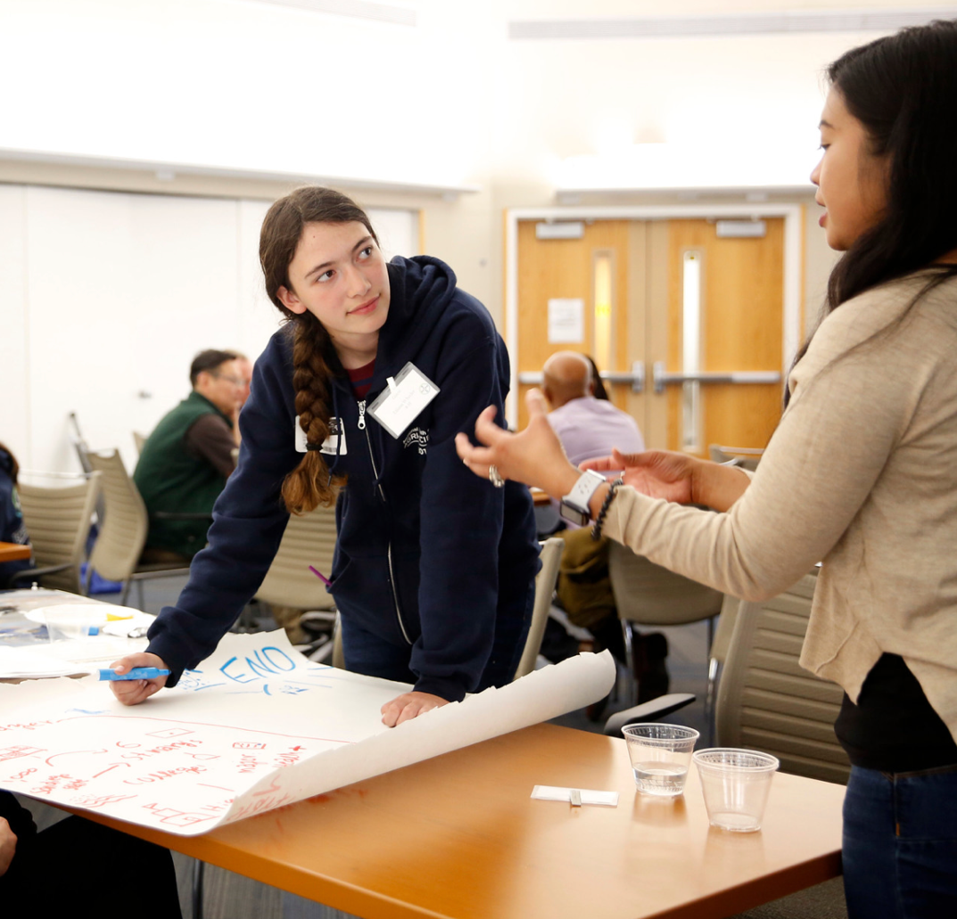
Key elements of developmental relationships
express care
challenge growth
provide support
share power
expand possibilities
(Roehlkepartain et al., 2017)
In 4-H, developmental relationships are often referred to as youth-adult partnerships or relationships with caring adults.

Slide 41

Increasing youth engagement in YAP means
Youth have opportunities to provide input and
take part in decision-making.
Youth experience a sense of belonging.
Youth have opportunities to develop and practice leadership.
Youth and adults are working together, sharing equally in the decision-making process and accomplishing tasks.

Slide 42
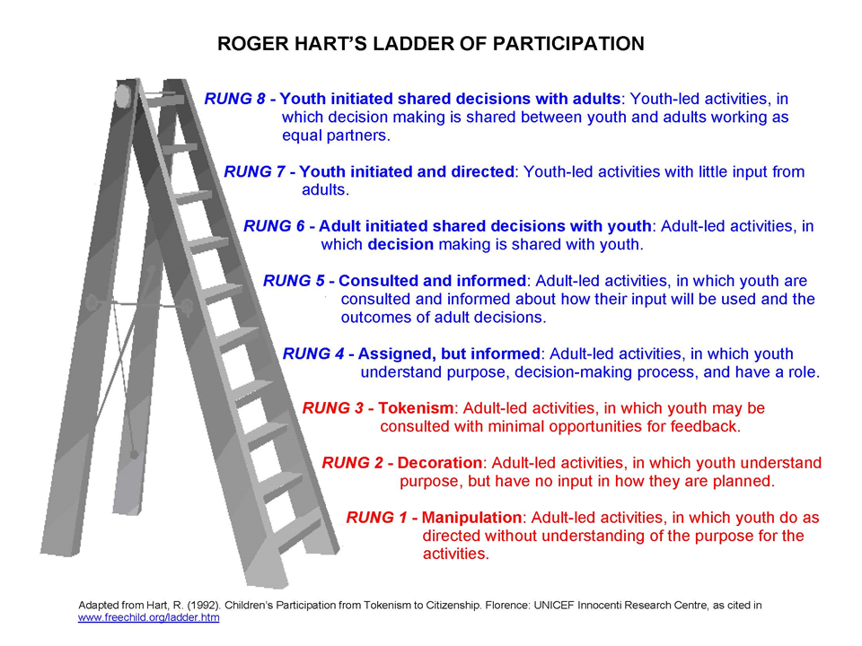
Where are we now? Where could we improve?

Slide 43

Who benefits from youth-adult partnerships?
4-H PROGRAM
YOUTH
COMMUNITY
ADULTS
COLLABORATING ORGANIZATIONS
Moving Ahead: Preparing the Youth Development Professional (2000)

Slide 44
For more information, contact:
Your Name, Your Title
your-email@fourhcouncil.edu

Slide 45
Activities
Practicing youth-adult partnerships–
Positive youth Development Domain

Slide 46
Mapping Youth-Adult Partnerships (YAP)
Make a list of all the groups, committees, teams, people, and organizations that make decisions for 4-H in your community or county.
Think about where youth are involved in the decision making of the various groups. Circle the groups that use youth-adult partnerships.
Now, think about the groups that could have youth-adult teams or that could increase the level of their youth-adult partnership. Put a star next to those groups to indicate where new opportunities exist.
Notes:
Activity Instructions
Mapping Youth-Adult Partnerships (YAP)
1. In groups of 3-4 people, ask participants to think about all the groups, committees, teams, people, and organizations that make decisions for 4-H in your community or county. Include the groups that you are a part of as well as those you are not a part of. Make a list of those groups.
2. Now ask participants to think about where youth are involved in the decision making of the various groups. Circle the groups that use youth-adult partnerships. Also, think about the level of the youth-adult partnership—is it token, or do the youth have a full voice and vote?
3. Now, think about the groups that could have youth-adult teams or that could increase the level of their youth-adult partnership. Put a star next to those groups to indicate where new opportunities exist.
Source: Innovation Center for Community and Youth Development, et al. (2003). Youth-Adult Partnerships: A Training Manual. Takoma Park, MD. pg. 90.

Slide 47
Stepping It Up
Your group will be assigned one or two rungs of the ladder on Hart's Ladder Handout and asked to develop a scenario that they have seen practiced, that demonstrates their assigned rung.
Share and discuss the scenarios.
Reflect on how to move your own youth participation and engagement practices to the next level.
Notes:
Activity Instructions
Stepping It Up
Divide the group into small groups of two to three people. Distribute Hart’s Ladder Handout to each person.
1.) Assign each group one or two rungs of the ladder. Ask the groups to come up with a scenario that they have seen practiced, that demonstrates their assigned rung.
2.) Return to the whole group and starting with the group assigned to Rung 1, share their scenarios.
3.) Discuss each scenario as it is presented.
4.) Reflect and discuss ideas on how to more their own youth participation and engagement practices to the next level.

Slide 49
Motivation and Sparks
Positive Youth Development Domain

Slide 50
Intrinsic and Extrinsic Motivation
Intrinsic motivation
comes from within
you engage in an activity because you enjoy it and get personal satisfaction from doing it
a spark can be a source of it
Extrinsic motivation
arises from external factors
you do something in order to gain an external reward or avoid an unpleasant outcome
(Ryan & Deci, 2000).

Slide 51
Sparks can:
Be a skill, talent or interest
Originate from inside a person, rather than being imposed from the outside
Be a source of intrinsic motivation, meaning and self-directed action that can help drive young people to put forth effort in other areas of their life
Make (or have the potential to make) the world a better place
Moving Ahead: Preparing the Youth Development Professional (2000)

Slide 52

Help a youth discover their spark:
assist a young person to feel comfortable exploring his/her sparks by acknowledging that some youth may already know their sparks, some youth may change their sparks, while others need time to discover theirs.
notice when a young person lights up and shows joy and positive energy toward something.
talk to a young person about what excites him/her.
listen carefully for a way to support a young person.
encourage youth to find ways to practice their spark(s).
attend a young person’s games, performances and public demonstrations of her or his spark(s).

Slide 53
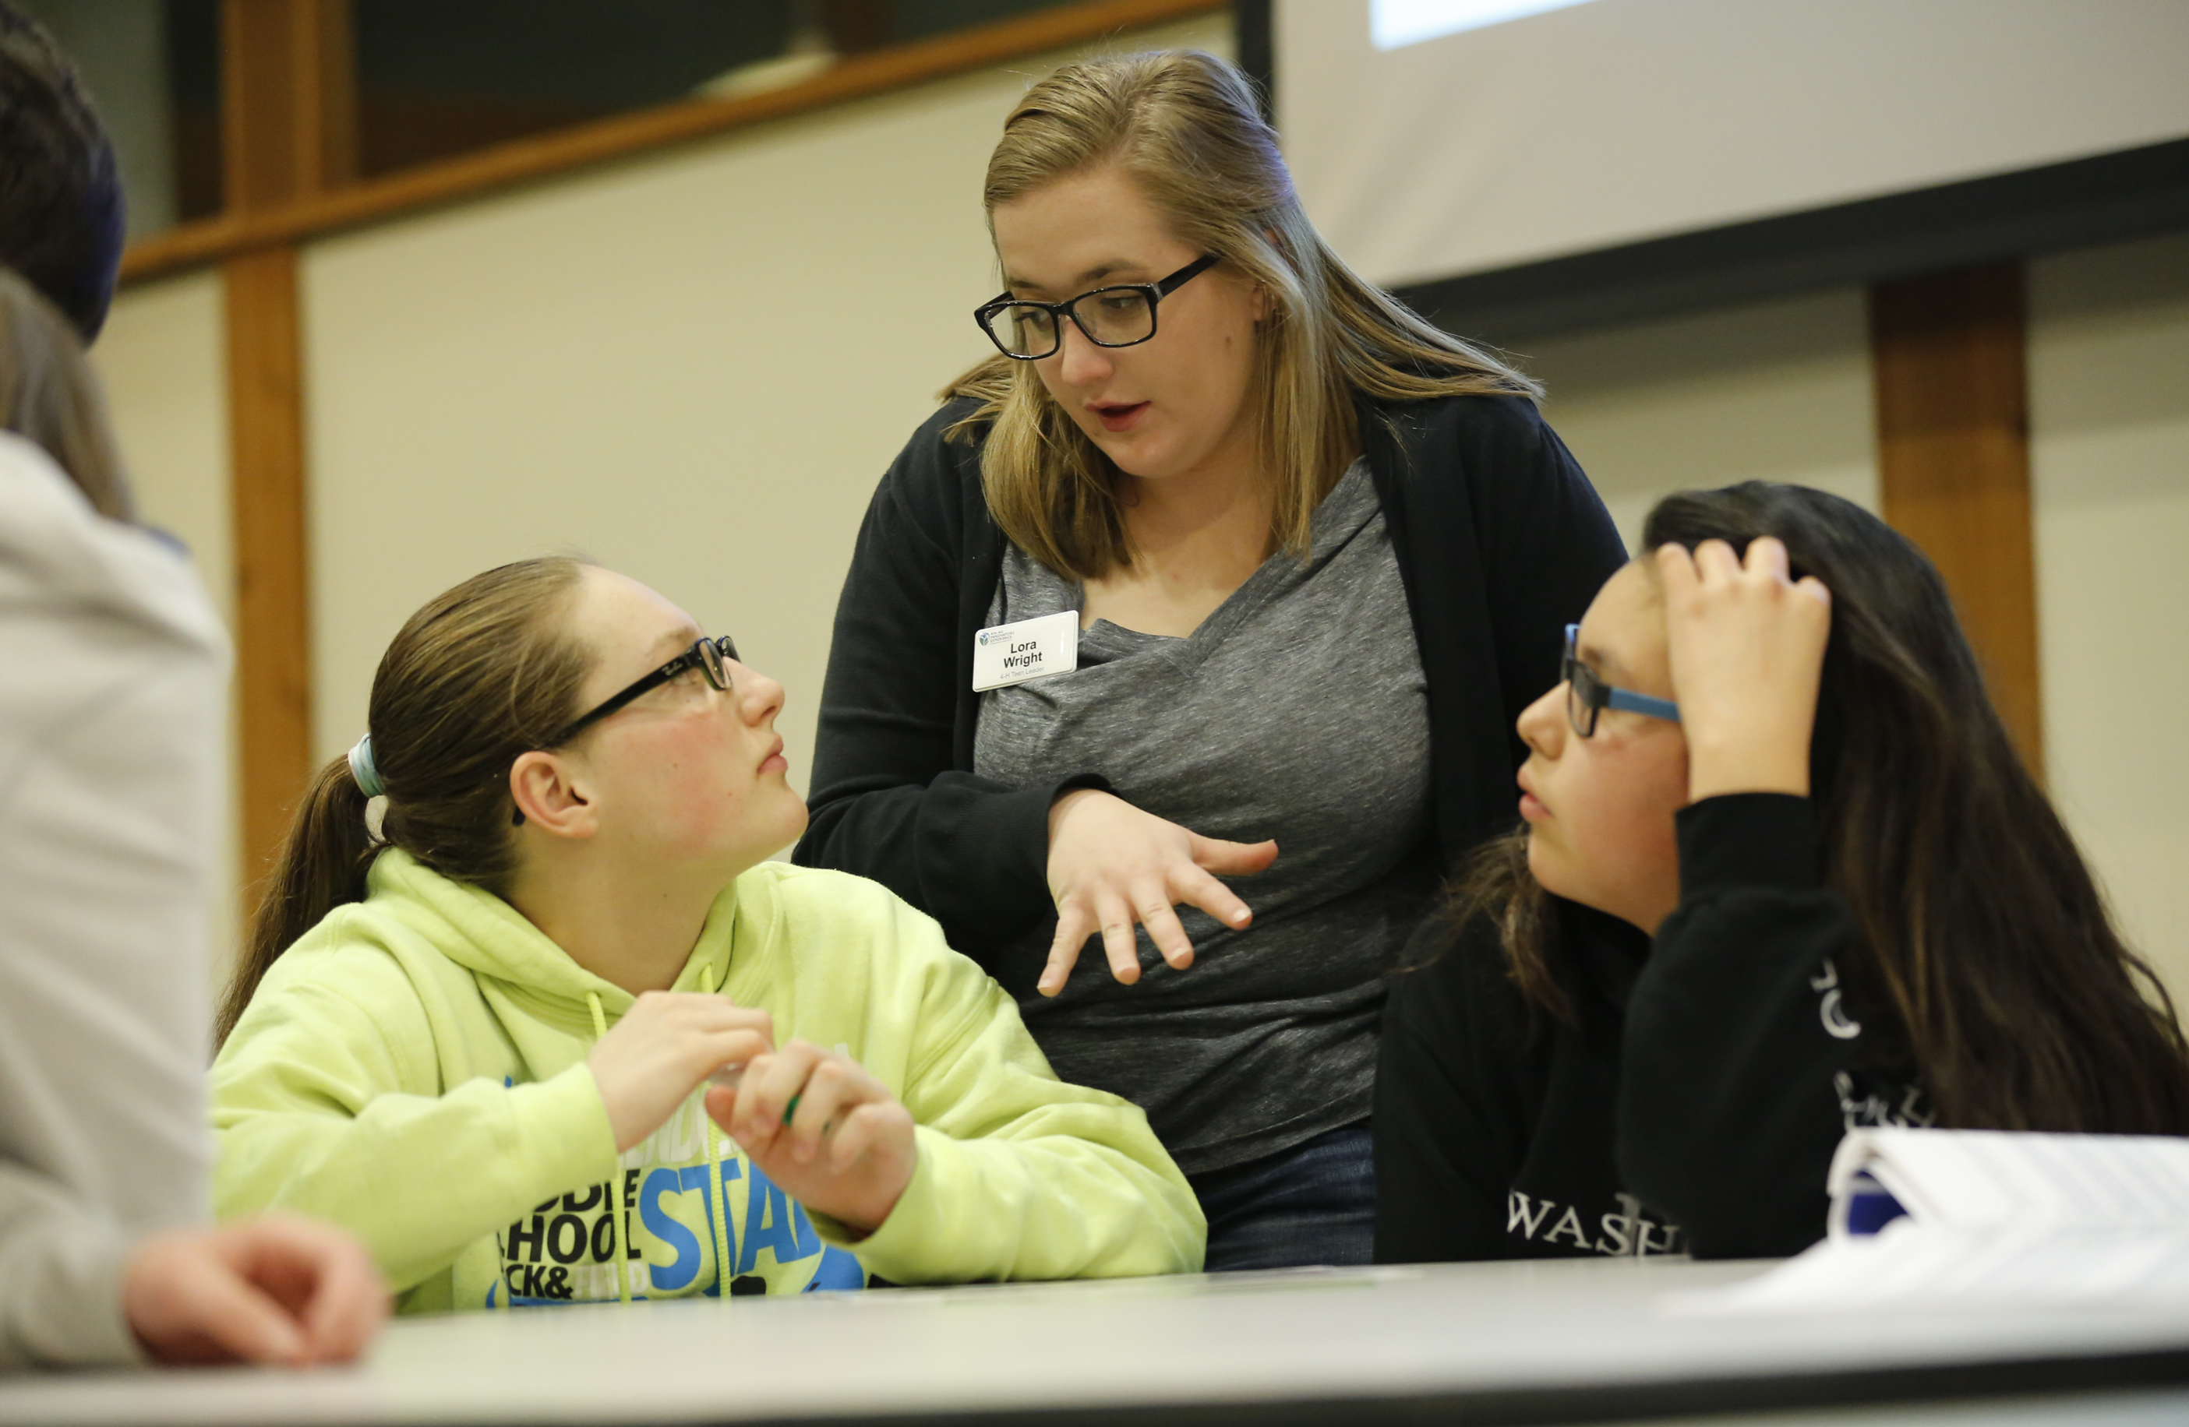
As a volunteer try not to:
use Sparks as a label (i.e., a “natural” ability, talent or attribute)
excessively match sparks to “career goals”
refer to a spark as “something you’re REALLY good at” (they may be passionate about something that needs effort and persistence before they’re “good” at it)

Slide 54
For more information, contact:
Your Name, Your Title
your-email@fourhcouncil.edu

Slide 55
Activities
Motivation and Sparks–
Positive youth Development Domain

Slide 56
Inside or Outside
Develop one scenario that you see in 4-H that is an example of extrinsic motivation and one scenario that shows intrinsic motivation.
Share scenarios.
Reflect and discuss.
Notes:
Activity Instructions
Inside or Outside
1.) Pair participants and ask them to come up with one scenario that they see in 4-H that is an example of extrinsic motivation and one scenario that shows intrinsic motivation.
2.) Return to the whole group to share scenarios.
3.) The whole group reflects and discusses.

Slide 57
Identifying Sparks
Compile a list of potential sparks that can be developed by youth in 4-H.
Share small group ideas.
What barriers or opportunity gaps may exist for young people that prevents them from practicing or nurturing their sparks?
Notes:
Activity Instructions
Identifying Sparks
1.) Divide the group into small groups of 3-4 people.
2.) Ask each group to come up with a list of potential sparks that can be developed by youth in 4-H.
3.) Return to the whole group and share small group ideas. How do they know when something is a spark? What key components need to be present for it to be something that can truly be called a spark?
4.) Discuss what barriers or opportunity gaps may exist for young people that prevents them from practicing or nurturing their sparks.

Slide 58
Spark Champions
Think of three strategies or skills you can develop as adult volunteers to help youth identify and nurture their sparks.
Share small group ideas.
What can you do as a spark champion to help reduce barriers or opportunity gaps for young people to practice their sparks?
Notes:
Activity Instructions
Sparks Champions
1.) Divide the group into small groups of 3-4 people.
2.) Ask each group to come up with 3 strategies or skills they can develop as adult volunteers to help youth identify and nurture their sparks.
3.) Return to the whole group and share small group ideas. Examples include: enhancing networks, goal setting, creating learning opportunities, different ways to explore new things
4.) Discuss what they can do as a spark champion to help reduce barriers or opportunity gaps for young people to practice their sparks.

Slide 59
What Motivates You?
Three areas in the room are labeled with signs: A, F and P.
Move to the sign that best describes you as the statements are read: A, F, P.
Notes:
Activity Instructions
What Motivates You?
Designate three areas in the room and label them with signs A, F and P. Have the group stand and tell them to move to the sign that best describes them as you read the statement.: A, F, P. Warm up with some basic, non-threatening questions such as: If you could pick today’s meal, would it be A - hamburgers, F - fish or P - pizza?
Ask the group these questions: Do you…
(A) Like to work alone; (F) Like to work with many people? (P) Try to shape people’s opinions?
(A) bore quickly; (F) take criticism hard; (P) act in charge?
(A) appreciate pins or certificates; (F) like to have a party to recognize achievement? (P) Like public recognition?
(A) like to be challenged in your activities? (F) Like to be part of a team, pair or group? (P) Like to be included in decision-making and planning?
Did you find yourself going to the same place in the room or were you all over? Share what the letters mean. They are 3 different intrinsic motivators. Were you surprised by the results?
(A) Achievement motivation - a drive to accomplish goals and new challenges
(F) Affiliation motivation - value placed on relationships and working with others
(P) Power motivation - value placed on influencing people and events for change.
There are many different factors that influence motivation and this activity explored three of them. Why is it important for a leader to know what motivates others? Or motivates themselves?
Acknowledgement: National 4-H Council (2008). Step Up to Leadership, Mentor Guide for Grades 6-12. National 4-H Curriculum BU-07904. PP. 20.

Slide 60
Access, Equity, Belonging & Diversity
Positive Youth Development Domain

Slide 61
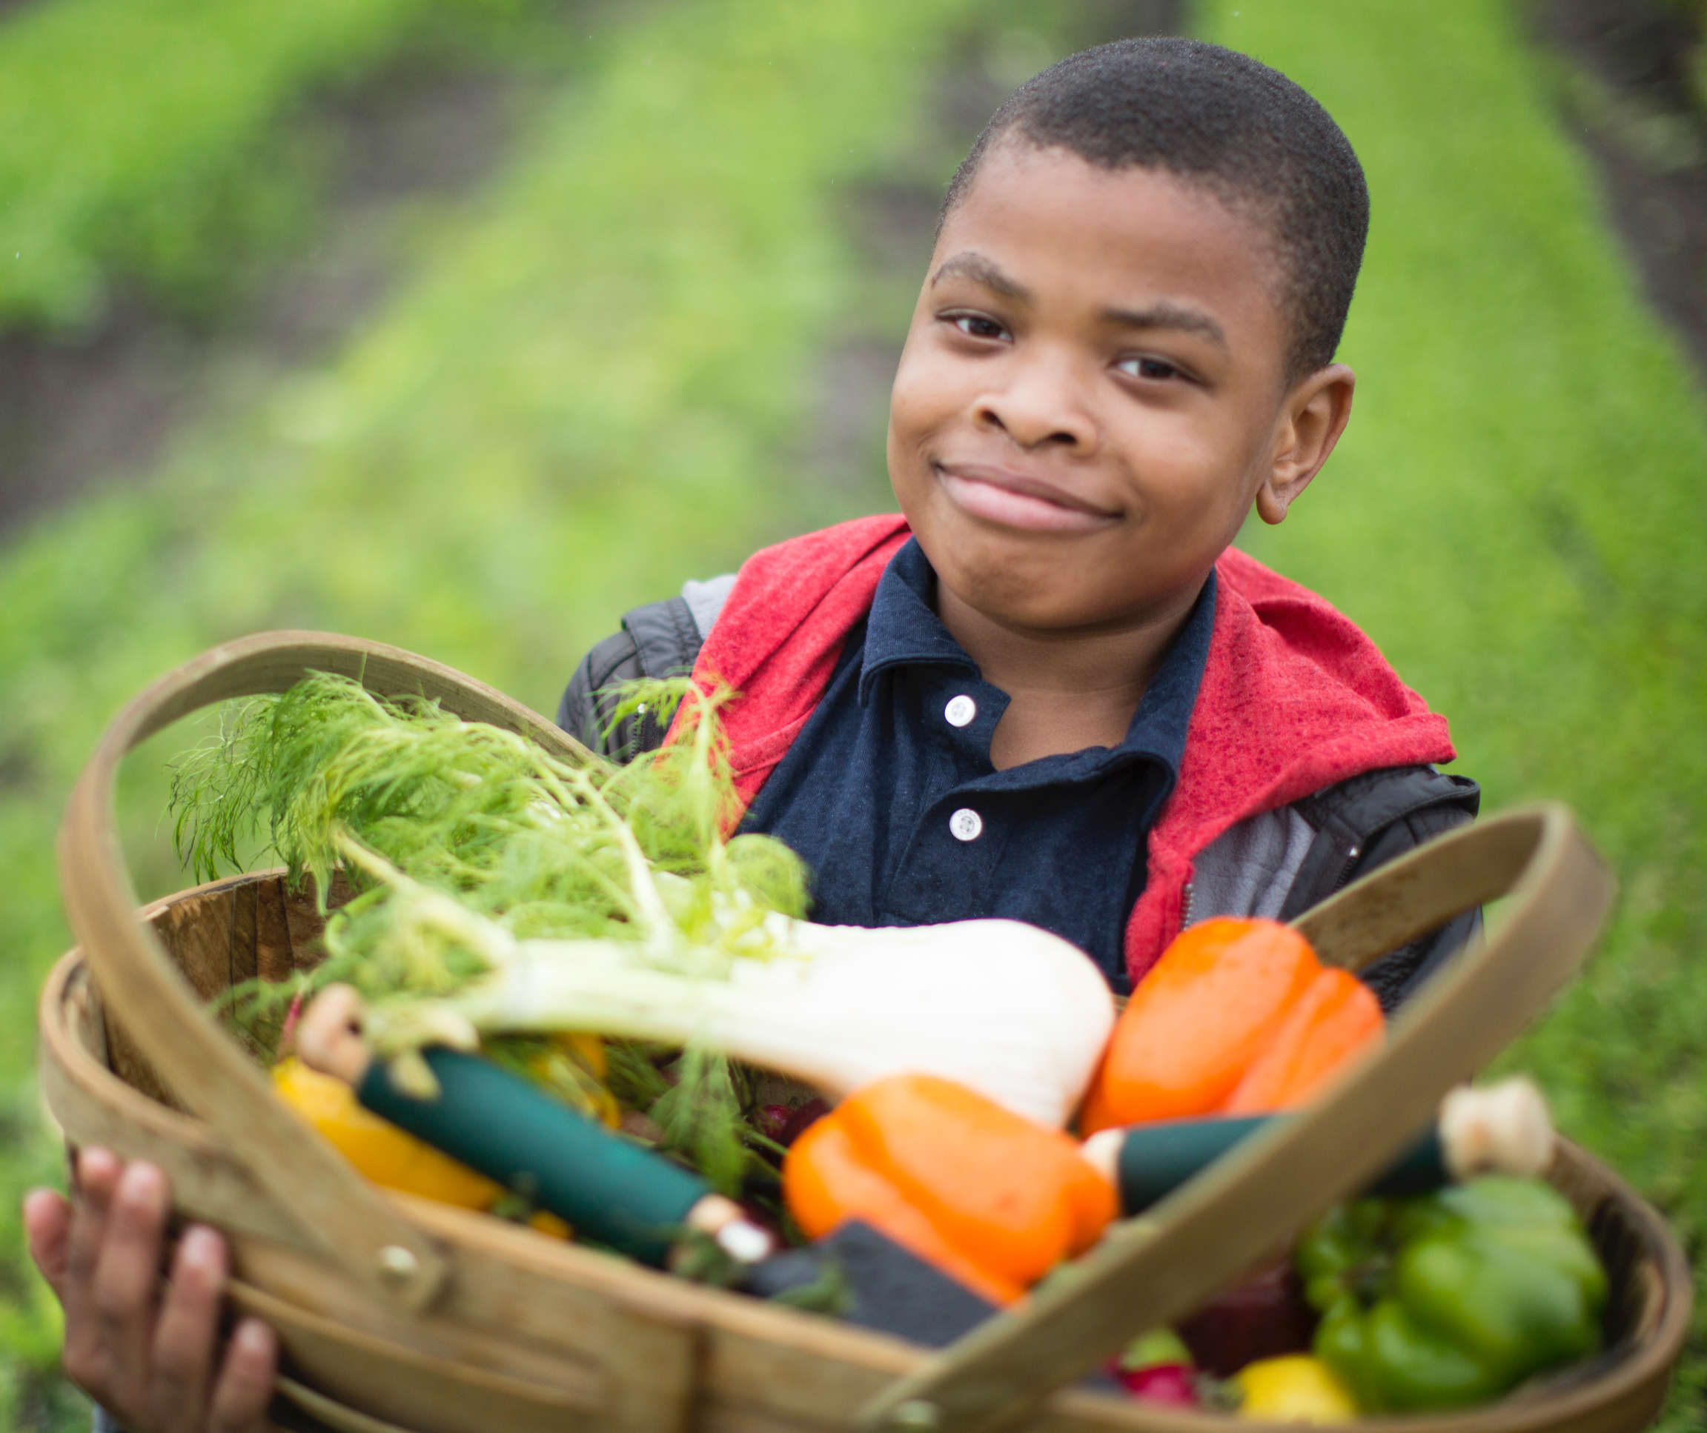
Terms to know
Diversity includes our unique identities such as age, race, ethnicity, socio-economic status, physical and mental ability, gender, sexual orientation, spiritual practices, employment status, geographic location, and other characteristics.
Equity means that everyone receives the unique resources and opportunities that they need to reduce or eliminate barriers to inclusion.
Inclusion is the act of creating spaces and places where each person has authentic value, respect, and support as part of the environment, group, and community.

Slide 62
Terms to know
Culture refers to the shared experiences of groups of people, including languages, values, customs, worldviews, and other attributes.
Implicit bias refers to the attitudes or stereotypes that affect our understanding, actions, and decisions unconsciously.
Social justice is the act of distributing power, resource, opportunity, societal benefits, and protection in a way that is equitable for all members of society.
Robust equity is the intentional promotion of thriving for all people in all communities and especially those that experience inequity and injustice.

Slide 63
As a volunteer working with 4-H youth you can:
practice social justice by distributing power and resources that are equitable
provide opportunities and resources that eliminate barriers to include all
reflect the diversity of your community
create spaces and places where each person has authentic value, respect, and support
4-H is a place where all youth can learn, grow, and thrive.

Slide 64
For more information, contact:
Your Name, Your Title
your-email@fourhcouncil.edu

Slide 65
Activities
Appreciating Diversity–
Positive youth Development Domain

Slide 66
Even Though I Am…
Make a list of as many items as you can, specific to you, completing this sentence:
“Even though I am______, I am not ________.”
Pair and share lists with one other person.
Join another pair to create a quad to reflect together. View the Reflection Handout and discuss each question.
Notes:
Activity Instructions
Even Though I Am…
1.) Ask participants to work individually for five minutes to make a list of as many items as they can, specific to them, completing this sentence:
“Even though I am______, I am not ________.”
2.) Pair and share lists with one other person for five minutes.
3.) Join two pairs into a quad to reflect together. Distribute the Reflection Handout and ask the group to discuss each question.
4.) Bring the full group back together and discuss:
What role does privilege play in this discussion?
What role do pride and shame play?

Slide 67
Exploring Culture
View the Iceberg Handout.
Think about a culture that you know a lot about.
Around the part of the iceberg that is seen above the waterline, write characteristics that are seen about that culture.
Around the part of the iceberg that is not seen—below the waterline, write characteristics that are not seen about that culture.
Notes:
Activity Instructions
Exploring Culture
1.) Distribute Iceberg Handout to each participant.
2.) Ask participants to think about a culture that they know a lot about.
3.) Around the part of the iceberg that is seen above the waterline, write characteristics that are seen about that culture.
4.) Around the part of the iceberg that is not seen—below the waterline, write characteristics that are not seen about that culture.
5.) In a large group, reflect and debrief the activity to reinforce the idea of culture.
Make meaning about why understanding culture helps volunteers in their work with youth.

Slide 68
Gender-Free Nouns (Diversity Toolkit, 2021)
As an entire group, describe what gender means. Describe what sexuality means.
In small groups, complete the Gender-Free Nouns Handout. Convert the suffixes of the nouns into gender-free, inclusive terms by changing the root word or by substitution.
Share ideas.
Notes:
Activity Instructions
Gender-Free Nouns (Diversity Toolkit, 2021)
1.) As an entire group, describe what gender means. Describe what sexuality Means.
2.) Distribute one Gender-Free Nouns Handout to small groups of 3-4 people, which they complete together. Convert the suffixes of the nouns into gender-free, inclusive terms by changing the root word or by substitution. It is okay to invent
new words, with something non-gendered.
3.) Ask small groups to share a few of their ideas. As a large group, reflect and debrief the activity to encourage participants to consider using non-gendered language, both written and spoken, in order to create more inclusive environments.

Slide 69
Barriers and Opportunity Gaps
Consider both current members and the community in general:
  identify barriers that prevent young people from participating in 4-H
  create solutions to these barriers
  identify opportunity gaps that 4-H creates that limit youth participation
  create solutions to these opportunity gaps
Share ideas, focus on how volunteers can create solutions to barriers and opportunity gaps for youth.
Notes:
Activity Instructions
Barriers and Opportunity Gaps
1.) Create small groups of 3-4 people.
2.) Ask each group to consider both current members and the community in general:
identify barriers that prevent young people from participating in 4-H
create solutions to these barriers
identify opportunity gaps that 4-H creates that limit youth participation
create solutions to these opportunity gaps
3.) Bring the whole group back together to share ideas with a focus on how volunteers can create solutions to barriers and opportunity gaps for youth.

