Slide 1
Speaking Skills
Communications Domain

Slide 2

Transactional Speaking
Speaking with the intent of conveying or communicating information
Examples:
Ordering food at a restaurant,
Giving a speech,
Providing directions over the phone,
Teaching a class, and
Debating political causes.

Slide 3
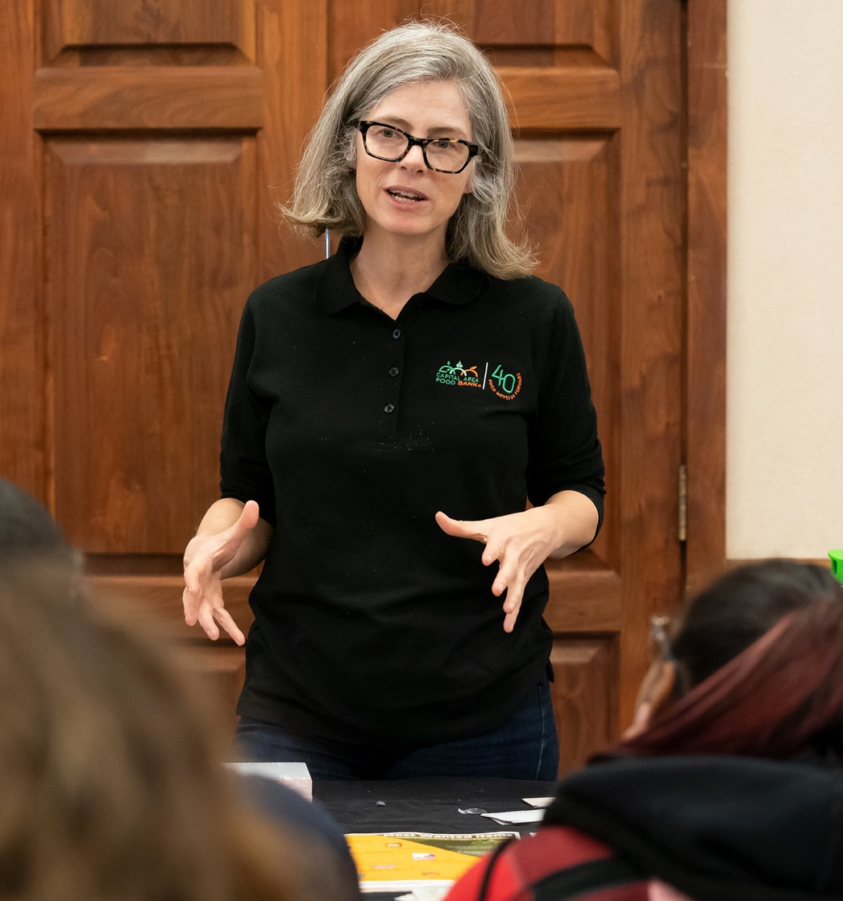
Tips to Transactional Speaking
Be prepared
Organize your thoughts (have notes ready to keep on track if necessary)
Reinforce key points
Reflect on how your statements will be perceived before you say them
Know when to stop talking

Slide 4

Interactional Speaking
Speaking with the primary intention of building a relationship and making a personal connection with someone
Examples:
Small talk,
Exchanging pleasantries, and
Other discussions on non-controversial topics
(i.e., the weekend, weather, work/school, etc.)

Slide 5



For more information, contact:
Your Name, Your Title
your-email@fourhcouncil.edu

Slide 6
Activity – Instruction Prompts
Speaking Skills – Communications Domain

Slide 7
Activity: Did You Get That?!
Listen to an example of transactional speaking
Share your observations
Work in small groups to create a “better” version
Make up what you don’t know to create your own example
Volunteer from each group will present your “improved” example
Reflect and discuss
Notes:
Activity Instructions
Did you Get that?!
.) A facilitator will set the stage with the group that a transactional speaking example will be presented, participants will share their observations surrounding the example, and work in groups to create and then share an improved example.
While the person is speaking, pay attention to the transactional speaking skills demonstrated (or lack thereof).
.) Either the facilitator or “volunteer” from the training audience will read and act out the embedded cues in the below script. The acting cues are indicated by brackets and italicized text: [example text].
Setting: 4-H Club Meeting  Adult Leader shares information related to participation in an upcoming holiday parade
Script: [Avoid eye contact with the group; look at the paper or glance out and above the audience; appear distracted and rushed]. Good afternoon, everyone! Quick update on the parade Tuesday [check your watch]. Anyone participating in the parade needs to meet our group behind the old firehouse at least 30 minutes before the parade starts. Parents, you can pick up your kids at the end of the parade route. [pick up your phone to check it]. If we’re successful, we’ll have that pizza party you all have been wanting so badly. If anyone has any questions, just let me know… [quickly leave the front of the audience so no one has the opportunity to ask questions].
.) The facilitator will seek input and feedback based on the observations of the example. What lingering questions do you anticipate you would have as a person in the audience?
Issues with provided, scripted example:
Speaker appears distracted and rushed
Speaker checks their watch and other devices
Speaker assumes there is some prior knowledge/understanding (are there any new people or guest in the audience?)
Little to no eye contact
Potentially vague: “Tuesday”, who can participate, can parents participate, meeting location and time (before and after parade), what is “successful”, how to ask questions/contact information.
.) Participants will work in groups to develop an improved example, keeping in mind what information needs to be communicated and anticipate/address questions the audience members might have.
.) Reflect on improved examples. How will you use your experience from participating in this activity moving forward?
Source: Written by T. Ashley Burns, Clemson University

Slide 8
Activity: Paper-Tearing Exercise
Take out a sheet of paper.
Follow instructions carefully.
No peeking!!!
You cannot ask any questions!!!
Share and discussion.
Notes:
Activity Instructions
Paper-Tearing Exercise
.) Pass out a sheet of paper to everyone and tell them the following: “We’re going to play a game that will show some important things about communication. Pick up a sheet of paper and hold it in front of you. Now, close your eyes and follow the directions I will give you—and no peeking! You cannot ask questions.”
.) Give the following directions, carrying them out yourself with your own sheet of paper and pausing after each instruction to give the group time to comply:
Fold your sheet of paper in half.
Tear off the upper right-hand corner.
Fold it in half again and tear off the upper left-hand corner.
Fold it in half again and tear off the lower right-hand corner.
.) After the tearing is complete, say something like, “Now open your eyes, and let’s see what you have. If I did a good job of communicating and you did a good job of listening, all of our sheets should look the same!”
.) Hold your sheet up for them to see and discuss outcome.
It is highly unlikely any sheet will match yours exactly.
How are our papers different?
Why don’t our papers match?
How could a different communication method have helped us with this activity?
Source: Strieter, L. (2008). Communications: Overview of Communications. Lesson Plan. VRKC: Volunteer Research Knowledge Competency. 4-H.org

Slide 9
Activity: Clip in My Pocket
"I have a clip in my pocket. It opens, closes, and holds things together. Without letting your neighbor see what you write, jot down a description of the type of clip you think it is."
Write down your response on a scrap of paper.
Share responses and discuss.
Notes:
Activity Instructions
Clip in My Pocket
.) Distribute something to write on (e.g., scrap of paper or post-it note) and with (e.g., pen or pencil) if needed.
.) Tell the group: "I have a clip in my pocket. It opens, closes, and holds things together. Without letting your neighbor see what you write, jot down a description of the type of clip you think it is."
.) Go around the room and share what everyone wrote down (list them on the flip chart and note the number of times a similar description is mentioned).
.) All of you heard the same thing: "I have a clip in my pocket. It opens, closes and holds things."
.) Ask the group these questions:
You received the very same information, so why are there this many different types of clips listed?
Why do you think it is the particular type of clip you wrote down?
How does your personal perspective influence your interpretation of what is said?
What questions could you ask to figure out what type of clip it is other than "What kind of clip is it?"?
.) By asking questions, you are developing a pool of shared meaning. Show the group the clip.
Source: Reaman, K. (2008). Communications: Overview of Communications. Lesson Plan. VRKC: Volunteer Research Knowledge Competency. 4-H.org

Slide 10
Activity: Interpersonal Introductions
Get in small groups (4-6 people)
Read your social cue.
Keep it a secret from your group members!
Role play an interpersonal conversation for 2 minutes.
Each group member should interact using their social cue.
Share and discussion.
Notes:
Activity Instructions
Interpersonal Introductions
.) Break into groups of 4 to 6 people.
.) Challenge: Each person in the group will be given a secret, social cue. Using the prompt provided by the facilitator, role play a conversation about [insert non-controversial topic – like introductions and the weather] for 2 minutes. (Do not tell others in the group what role you have.)
The facilitator will have pre-labeled pieces of paper with the following social roles on them:
. Interrupter: You love to interrupt the person talking with impertinent comments.
. Close Talker: You get in everyone’s personal space when they talk.
. Bragger: You always turn the conversation to you and brag about your own experiences.
. Distracted: You occasionally participate in the conversation, but you have more important things to do elsewhere (wrap it up).
. Hater: You don’t like or agree with anything anyone says.
. Facilitator: You try your best to engage everyone in the group to get their input, as well as keep the conversation light hearted and on topic.
.) Discussion and reflection (Share roles and dynamics of the interaction)
Source: Written by T. Ashley Burns, Clemson University

Slide 12
Listening Skills
Communications Domain

Slide 13

Active Listening
requires the listener to fully concentrate, understand, respond and then remember what is being said

Slide 14

Mindfulness
paying attention in a particular way, on purpose, in the present moment – and non-judgmentally

Slide 15

Tips to Improve Listening Skills
Simply listen
Convey interest
Reduce distractions
Listen for feelings
Repeat what you heard
Ask questions
Create silence
Refrain from offering advice

Slide 16
For more information, contact:
Your Name, Your Title
your-email@fourhcouncil.edu

Slide 17
Activity – Instruction Prompts
Listening Skills – Communications Domain

Slide 18
Activity: Listening Skills Inventory
Take a Listening Skills Inventory
Discuss Results
What are some things you do that make you an active listener?
How comfortable are you with your skills as an active listener?
What might be a potential strategy to be a better listener?
Notes:
Activity Instructions
Listening Inventory
.) Take an online Listening Skills Inventory
Potential options:
How Good Are Your Listening Skills? by Mind Tools (online): https://www.mindtools.com/pages/article/listening-quiz.htm
Self-Assessment for Active Listening by Center for Executive Excellence (printable): https://executiveexcellence.com/wp-content/uploads/2019/05/ActiveListening-SelfAssessment_Fillable.pdf
.) Discuss Results
What are some things you do that make you an active listener?
How comfortable are you with your skills as an active listener?
What might be a potential strategy to be a better listener?

Slide 19
Activity: Shhhh. Just listen...
Work in pairs - Select one person to be the listener and one person to be the speaker.
Challenge: The listener has to get the speaker to continue talking for 5 minutes, but can only make three statements during the time period.
The speaker will talk about a situation that was a joyous occasion.
Switch roles after 5 minutes.
Return to whole group for reflection and discussion.
Notes:
Activity Instructions
Shhhh. Just Listen…
.) Work in pairs - Select one person to be the listener and one person to be the speaker.
.) Challenge: The listener has to get the speaker to continue talking for 5 minutes, but can only make three statements during the time period.
The speaker will talk about a situation that was a joyous occasion (ex. might be an award, a special event, a new job, etc.).
.) Switch roles after 5 minutes.
.) Return to whole group for reflection and discussion. The discussion that follows concentrates on how:
The speaker felt when the person just listened and did not exchange information
The nonverbal signals encouraged the speaker
Uncomfortable the silence was
It felt to just listen without having the pressure to contribute
The speaker felt having the freedom to say whatever they felt
Source: Listening & Communication Exercises by Work Smart Blog, Posted online by Leslie Orr http://blog.trainerswarehouse.com/communication-exercises

Slide 20
Activity: What’s Your Problem?
Work in Pairs - One person is a club leader, one person is an upset parent or volunteer.
Role play: The club leader has to get the speaker to continue talking for 5 minutes, but can only make three statements during the time period.
During the role play, practice the following steps:
Use active listening
Don’t make any promises
Acknowledge the person’s frustration and let them vent
Move on to problem solving
Notes:
Activity Instructions
What’s your Problem?
.) Work in Pairs - One person is a club leader, one person is an upset parent or volunteer.
.) Role play: The club leader practices active listening and tries to diffuse the tense situation. The parent/volunteer is upset because of [fill in any scenario].
.) Discussion: The best way to diffuse a tense situation is to use active listening – it is important that the person knows you hear what they are saying. It is also important not to make any promises at that stage of the exchange. Acknowledge the person’s frustration and let them vent. Then, move on to problem solving – get the person to help in solving the problem and then work on solving it together.
Source: Listening & Communication Exercises by Work Smart Blog, Posted online by Tom Lord http://blog.trainerswarehouse.com/communication-exercises

Slide 21
Activity: Clip in My Pocket
"I have a clip in my pocket. It opens, closes, and holds things together. Without letting your neighbor see what you write, jot down a description of the type of clip you think it is."
Write down your response on a scrap of paper.
Share responses and discuss.
Notes:
Activity Instructions
Clip in My Pocket
.) Distribute something to write on (e.g., scrap of paper or post-it note) and with (e.g., pen or pencil) if needed.
.) Tell the group: "I have a clip in my pocket. It opens, closes, and holds things together. Without letting your neighbor see what you write, jot down a description of the type of clip you think it is."
.) Go around the room and share what everyone wrote down (list them on the flip chart and note the number of times a similar description is mentioned).
.) All of you heard the same thing: "I have a clip in my pocket. It opens, closes and holds things."
.) Ask the group these questions:
You received the very same information, so why are there this many different types of clips listed?
Why do you think it is the particular type of clip you wrote down?
How does your personal perspective influence your interpretation of what is said?
What questions could you ask to figure out what type of clip it is other than "What kind of clip is it?"?
.) By asking questions, you are developing a pool of shared meaning. Show the group the clip.
Source: Reaman, K. (2008). Communications: Overview of Communications. Lesson Plan. VRKC: Volunteer Research Knowledge Competency. 4-H.org

Slide 23
Writing Skills
Communications Domain

Slide 24

Clear, concise writing
Saves time,
Reduces stress,
Prevents misunderstanding, and
Helps the receiver(s) to respond quickly and appropriately.
Writing is a concrete form of documentary evidence that can be used for future reference.

Slide 25

Tips for Effective Writing
Know your audience
Think like a reporter
Consider how your message will be interpreted
Keep it short
Proofread

Slide 26
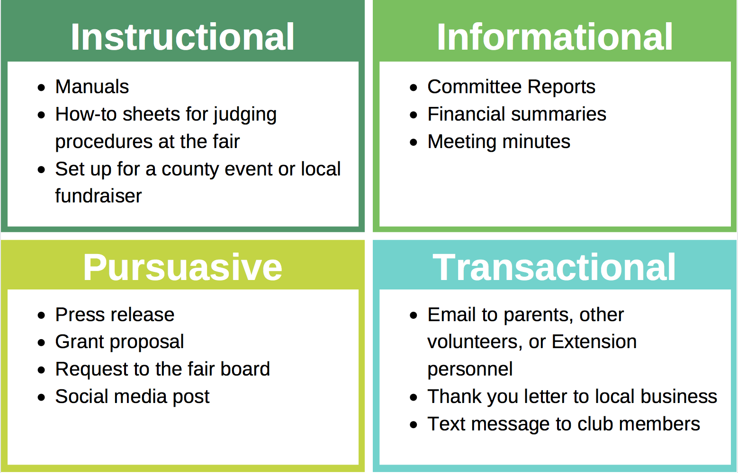
Four Types of Written Communication

Slide 27
For more information, contact:
Your Name, Your Title
your-email@fourhcouncil.edu

Slide 28
Activity – Instruction Prompts
Writing Skills – Communications Domain

Slide 29




Activity: What’s Wrong with this Message?!
Text message to 4-H club members:
Hey everyone! Looking forward to seeing you at our club meeting later this week! Don’t forget your stuff and be sure to bring the form.
Notes:
Activity Instructions
What’s Wrong with this Message?
.) Provide a few different email/text messages samples.
.) Ask participants to identify what type of communication each represents.
Text message to 4-H Club members: Hey everyone! Looking forward to seeing you at our club meeting later this week! Don’t forget your stuff and be sure to bring the form.
Email message re: preparation for the Fair Exhibit Hall: Don’t forget to bring you’re projects too the exhibit Hall next week on tuesday. We talked about the steps you need to follow at are last meeting. remember there is a limit on how many things you can enter. Call me if you have questions.
Letter to 4-H Leaders’ Association: Dear leaders - I think you made a bad decision when you took away some of the camp scholarships. Our 4-H members really enjoy going to the state 4-H camp but now they can’t go because of the decision you made about reducing the number of scholarships. You should really offer more scholarships.
.) Review (transactional, persuasive, instructional, informational) and point out what could be improved based on writing tips provided in the Writing Skills Fact Sheet.
.) As an alternate activity, ask participants to choose one type of communication related to their 4-H experience and draft a message for a partner to review and critique.
Source: Written by Jen Lobley, University of Maine

Slide 30
Activity: What’s Wrong with this Message?!
Email message re: preparation for the Fair Exhibit Hall: Don’t forget to bring you’re projects too the exhibit Hall next week on tuesday. We talked about the steps you need to follow at are last meeting. remember there is a limit on how many things you can enter. Call me if you have questions.
Notes:
Activity Instructions
What’s Wrong with this Message?
.) Provide a few different email/text messages samples.
.) Ask participants to identify what type of communication each represents.
Text message to 4-H Club members: Hey everyone! Looking forward to seeing you at our club meeting later this week! Don’t forget your stuff and be sure to bring the form.
Email message re: preparation for the Fair Exhibit Hall: Don’t forget to bring you’re projects too the exhibit Hall next week on tuesday. We talked about the steps you need to follow at are last meeting. remember there is a limit on how many things you can enter. Call me if you have questions.
Letter to 4-H Leaders’ Association: Dear leaders - I think you made a bad decision when you took away some of the camp scholarships. Our 4-H members really enjoy going to the state 4-H camp but now they can’t go because of the decision you made about reducing the number of scholarships. You should really offer more scholarships.
.) Review (transactional, persuasive, instructional, informational) and point out what could be improved based on writing tips provided in the Writing Skills Fact Sheet.
.) As an alternate activity, ask participants to choose one type of communication related to their 4-H experience and draft a message for a partner to review and critique.
Source: Written by Jen Lobley, University of Maine

Slide 31
Activity: What’s Wrong with this Message?!
Letter to 4-H leaders association/council:
Dear leaders-
I think you made a bad decision when you took away some of the camp scholarships. Our 4-H members really enjoy going to camp but now they can’t go because of the decision you made. You should really offer more scholarships.
Notes:
Activity Instructions
What’s Wrong with this Message?
.) Provide a few different email/text messages samples.
.) Ask participants to identify what type of communication each represents.
Text message to 4-H Club members: Hey everyone! Looking forward to seeing you at our club meeting later this week! Don’t forget your stuff and be sure to bring the form.
Email message re: preparation for the Fair Exhibit Hall: Don’t forget to bring you’re projects too the exhibit Hall next week on tuesday. We talked about the steps you need to follow at are last meeting. remember there is a limit on how many things you can enter. Call me if you have questions.
Letter to 4-H Leaders’ Association: Dear leaders - I think you made a bad decision when you took away some of the camp scholarships. Our 4-H members really enjoy going to the state 4-H camp but now they can’t go because of the decision you made about reducing the number of scholarships. You should really offer more scholarships.
.) Review (transactional, persuasive, instructional, informational) and point out what could be improved based on writing tips provided in the Writing Skills Fact Sheet.
.) As an alternate activity, ask participants to choose one type of communication related to their 4-H experience and draft a message for a partner to review and critique.
Source: Written by Jen Lobley, University of Maine

Slide 32
Activity: Write it Up!
Choose a recent 4-H event or activity (club, county, state or national).
Write a concise informative communication.
Address the 5 W’s
Who
What
Where
When
Why
Share write up with small groups for feedback.
Notes:
Activity Instructions
Clip in My Pocket
.) Distribute something to write on (e.g., scrap of paper or post-it note) and with (e.g., pen or pencil) if needed.
.) Tell the group: "I have a clip in my pocket. It opens, closes, and holds things together. Without letting your neighbor see what you write, jot down a description of the type of clip you think it is."
.) Go around the room and share what everyone wrote down (list them on the flip chart and note the number of times a similar description is mentioned).
.) All of you heard the same thing: "I have a clip in my pocket. It opens, closes and holds things."
.) Ask the group these questions:
You received the very same information, so why are there this many different types of clips listed?
Why do you think it is the particular type of clip you wrote down?
How does your personal perspective influence your interpretation of what is said?
What questions could you ask to figure out what type of clip it is other than "What kind of clip is it?"?
.) By asking questions, you are developing a pool of shared meaning. Show the group the clip.
Source: Reaman, K. (2008). Communications: Overview of Communications. Lesson Plan. VRKC: Volunteer Research Knowledge Competency. 4-H.org

Slide 34
Nonverbal Communication Skills
Communications Domain

Slide 35

Nonverbal Communication is
How words are spoken (tone, pitch, pace),
Body language (gestures, facial expressions, posture),
Non-language sounds (whistling, clapping, sighing),
Visual cues (symbols, motions), and
Tactile responses (touching)
Notes:
What are some nonverbal cues you see in this picture? (Thumbs up, Leaning forward, smiling, relaxed posture)
What does it tell you?

Slide 36
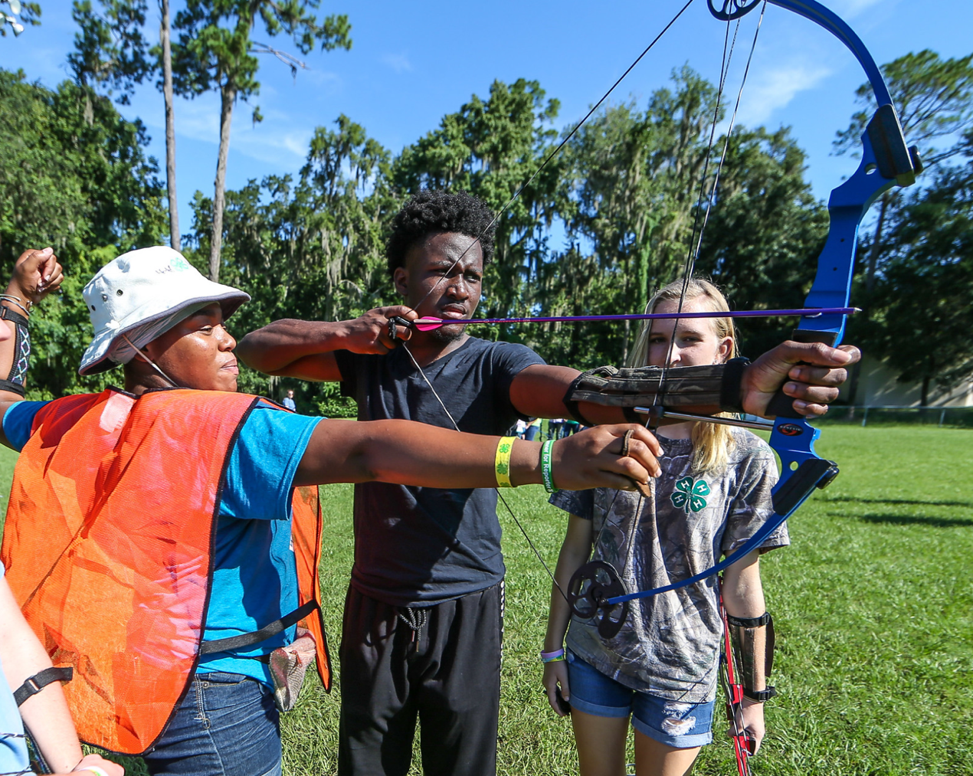
Three Purposes of Nonverbal Communication
Convey emotions and attitudes behind spoken language,
Support or compliment words, and
Replace verbal communication
Notes:
What are some nonverbal cues you see in this picture? (Scrunched up brow, demonstrating gestures)
What does it tell you?

Slide 37

Be Mindful of Nonverbal Cues
Words and nonverbal cues should send the same message
Posture and expression in active listening show engagement to the speaker
Voice fluctuations, tone, and pace have impact on the listener
Distracting cues can send the wrong message
Culture can influence the use and perception of nonverbal communication
It is okay to seek clarification if you do not understand a nonverbal cue

Slide 38
For more information, contact:
Your Name, Your Title
your-email@fourhcouncil.edu

Slide 39
Activity – Instruction Prompts
Nonverbal Skills – Communications Domain

Slide 40
Activity: Brainstorm it!
Work individually - Write down as many examples of nonverbal communication as you can in 1 minute.
Share.
Group/organize by:
How words are spoken (tone, pitch, pace),
Body language (gestures, facial expressions, posture),
Non-language sounds (whistling, clapping, sighing),
Visual cues (symbols, motions), or
Tactile responses (touching)
Notes:
Activity Instructions
Brainstorm it!
In one minute, have participants write down as many examples of nonverbal communication as they can.
Go around the room and have people share their list, writing down all the examples.
This part can be turned into a competition (inspired by the game Scattergories) by giving individuals get one point for each unique answer they have. (If no one else wrote down that same nonverbal cue they get a point.) The person(s) with the most points after everyone has shared wins!
Review the list and group cues by the following categories:
How words are spoken (tone, pitch, pace),
Body language (gestures, facial expressions, posture),
Non-language sounds (whistling, clapping, sighing),
Visual cues (symbols, motions), and
Tactile responses (touching)
Review and discuss.
What type of cue was most commonly mentioned? What cues do you think have the most powerful communication? What cues could be misinterpreted?
Written by: T. Ashley Burns, Clemson University

Slide 41
Activity: The Power of Nonverbal
Work in Pairs - One person is the speaker; the other person will communicate with nonverbal cues only
Challenge: The speaker will talk for 2 minutes, regardless of the cues by the other person.
The listener will be given an adjective they will use nonverbal cues to communicate.
Switch roles and repeat for 2 minutes.
Share and Discuss.
Notes:
Activity Instructions
The Power of Nonverbal
Ask individuals to work in pairs. One person in the pair will be the designated speaker and the other person will communicate with nonverbal cues only.
Challenge: The speaker will continue talking (about any subject) regardless of the cues the other person is giving to 2 minutes. The non-speaker will roll a dice to determine what message they will be giving off with nonverbal cues. (If the facilitator wants to keep the adjectives secret from the speaker, they can simply whisper the desired cue or have pre-labeled pieces of paper.)
Engaged - Super interested in what the speaker is saying!
Apathetic - Not interested one bit.
Angry - Very opposed to what the speaker is saying.
Distracted - Interested in speaker, but really need to go to the bathroom.
Distracted - Not very interested; anxiously waiting for a call, text, or email.
Tired - Exhausted and having difficulty concentrating.
After 2 minutes, have the speaker try to guess what nonverbal cue was communicated.
Switch roles and repeat for 2 additional minutes.
Discuss and reflect on the impact nonverbal cues have on the speaker
Share roles and dynamics of the interaction (E.g., Continuing to speak when someone is clearly not interested is very difficult. The speaker can generally figure out what message the nonverbal communication is saying.)
Written by: T. Ashley Burns, Clemson University

Slide 42
Activity: Decipher the Message
Observe an example of nonverbal communication.
Share your interpretation.
Discuss.
Notes:
Activity Instructions
Decipher the Message
Using the pictures in the Nonverbal Communication Skills slide deck or other facilitator-selected pictures or video clips, observe an example of nonverbal communication.
Discuss possible interpretations (starting from the participants’ perspective) and discuss that those interpretations are valid. (Share in small groups of 4-5 if the audience is more than 15 people. Each group can report back to the larger group.)
If there is an alternative interpretation, the facilitator can share it to emphasize the importance of context, culture, or other meaning in nonverbal communication.
Written by: T. Ashley Burns, Clemson University

Slide 44
Information Delivery and Dissemination
Communications Domain

Slide 45
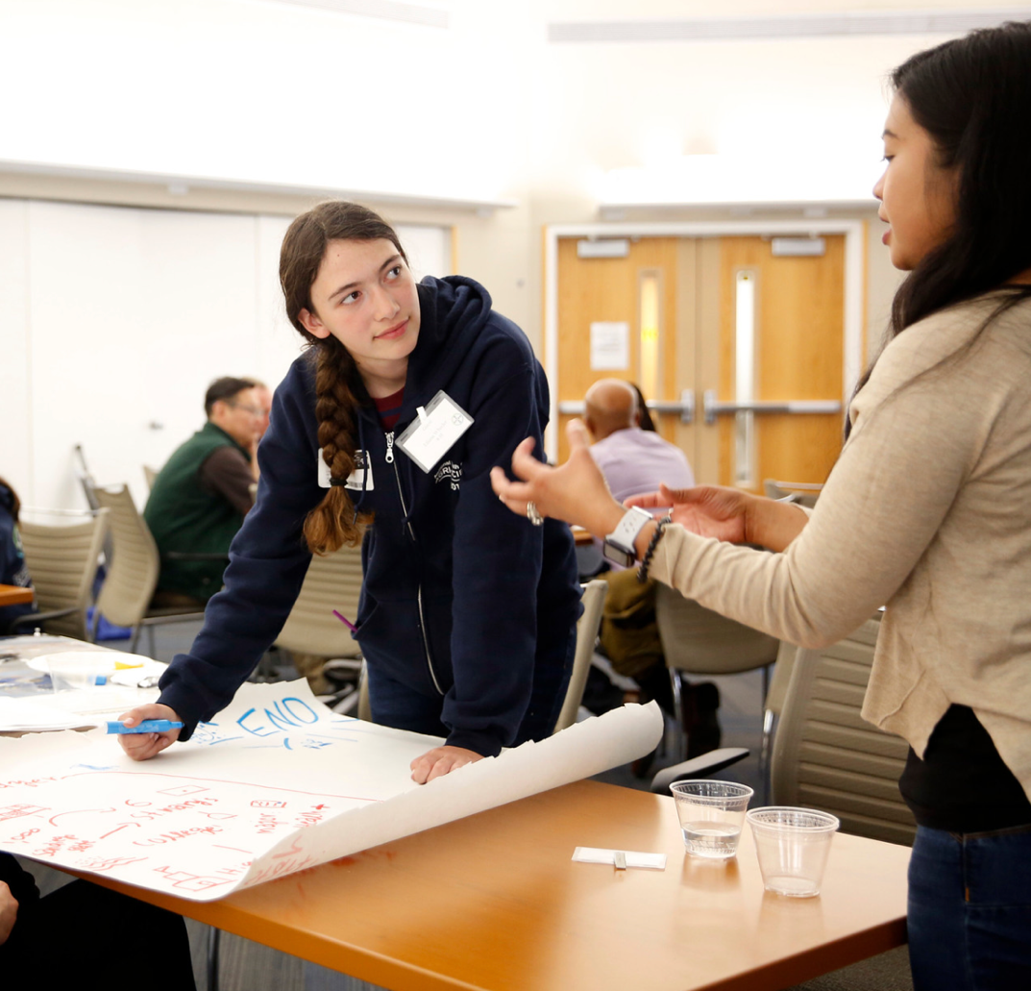
Effective Dissemination of Information
Step 1. Define your target audience.
Step 2. Consider audience preferences to receive information.
Step 3. Examine your topic and purpose.
Step 4. Select and information delivery method.

Slide 46

Common Delivery and Dissemination in 4-H
Face-to-face. Club or council meetings, afterschool or school enrichment presentations, interview judging, camping trips or other Extension workshops or events
Print-based. Newsletter, brochure, press release, direct mail or annual report
Web-based. Downloadable publications, webinars, video streaming, email, websites, video meetings, and social media

Slide 47
For more information, contact:
Your Name, Your Title
your-email@fourhcouncil.edu

Slide 48
Activity – Instruction Prompts
Information Delivery & Dissemination – Communications Domain

Slide 49
Activity: Target Audience
In small groups or pairs:
Choose your target audience.
List characteristics of the target audience.
Determine how you will market to this audience.
List key components you will include in your message.
Report out to the larger group.
Would the marketing message change if you had a different target audience?
Change your target audience and discuss with your group how your marketing efforts might change.
Notes:
Activity Instructions
Target Audience
In small groups or pairs:
Choose your target audience.
List characteristics of the target audience.
Determine how you will market to this audience.
List key components you will include in your message.
Report out to the larger group.
Would the marketing message change if you had a different target audience?
Change your target audience and discuss with your group how your marketing efforts might change.
Review and discuss.
Written by: Jen Lobley, University of Maine

Slide 50
Activity: What’s your Point?!
Work in pairs to write down:
Any type of 4-H topic you might want to share with someone else in 4-H.
The objective/purpose of sharing this information.
Discuss with your partner 2-3 different ways you might share the information and the pros and cons for each of them.
Notes:
Activity Instructions
What’s your Point?!
Work in pairs to write down:
Any type of 4-H topic you might want to share with someone else in 4-H.
The objective/purpose of sharing this information.
Discuss with your partner 2-3 different ways you might share the information and the pros and cons for each of them.
Review and discuss.
Written by: Jen Lobley, University of Maine

Slide 52
Marketing and Public Relations
Communications Domain

Slide 53

Marketing Communication Plan
Work in partnership with county staff.
Be intentional when communicating about 4-H.
Emphasize the connection between 4-H and the land-grant university.

Slide 54
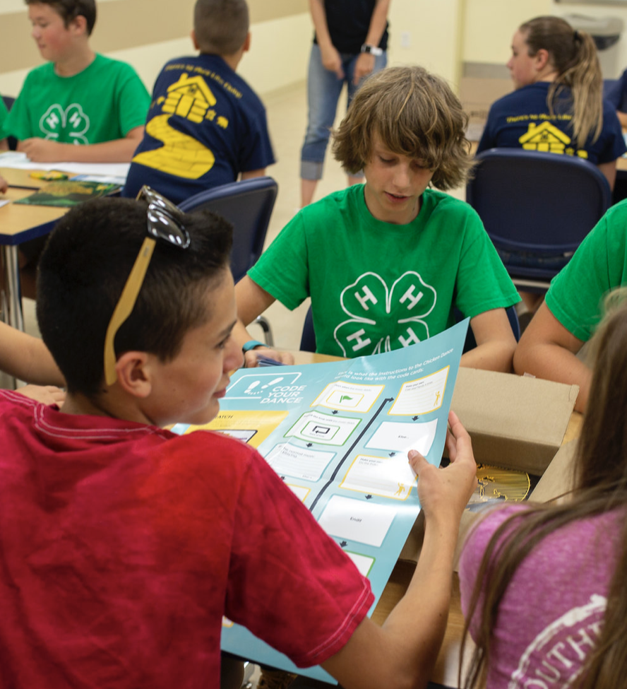
Effective Communication Plans include:
Make implementation decisions.
Create a marketing strategy.
Evaluate communication efforts.

Slide 55

Program Marketing and Promotion
Understand cultural beliefs.
Utilize 4-H marketing and promotion resources.
Develop and utilize high quality resources.
Engage in strategic marketing.
Tell your story to stakeholders.
Provide branded items to everyone.

Slide 56
For more information, contact:
Your Name, Your Title
your-email@fourhcouncil.edu

Slide 57
Activity – Instruction Prompts
Marketing & Public Relations – Communications Domain

Slide 58

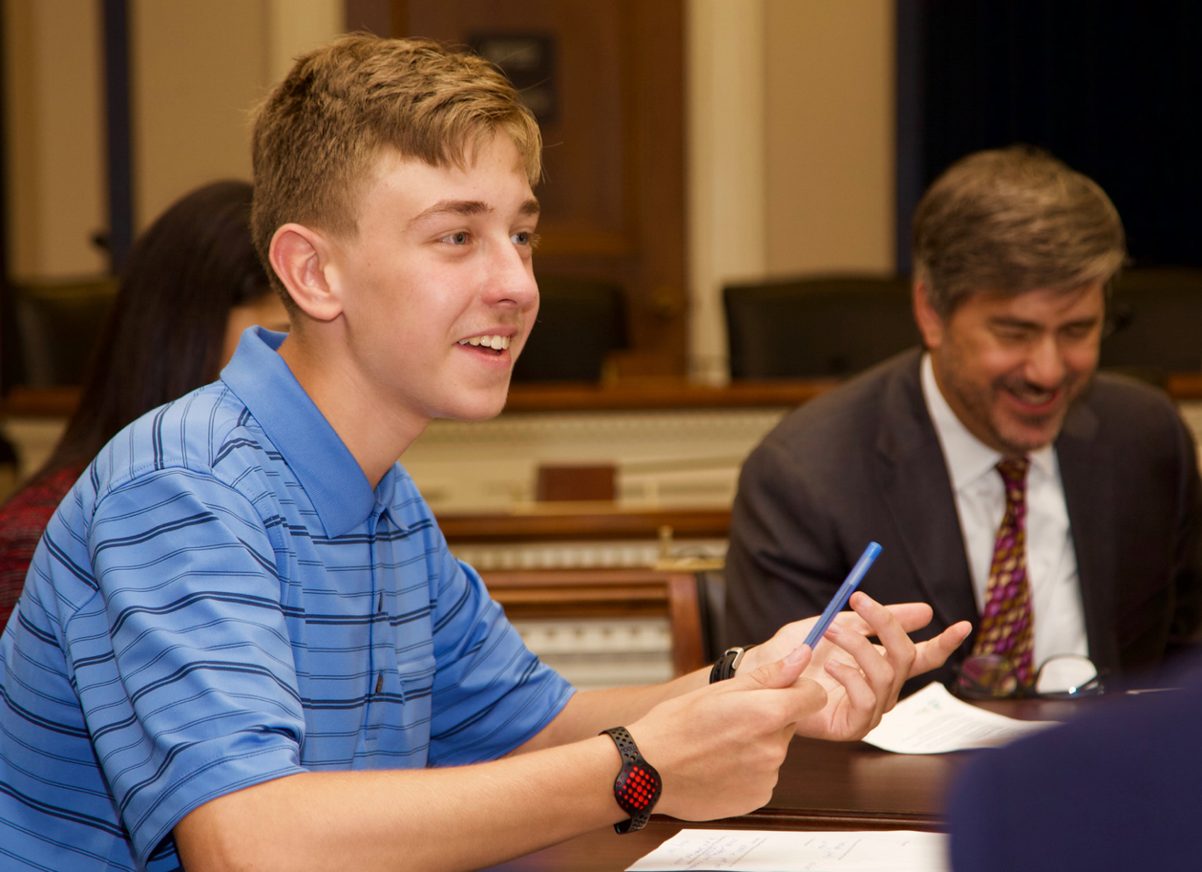
Activity: What’s Your Elevator Speech
What is an Elevator Speech?
Brainstorm key concepts.
Write an elevator speech.
Practice and discuss with a partner.
Notes:
Activity Instructions
What’s Your 4-H Elevator Speech?
Lead in: When someone asks you, “What is 4-H?” how do you respond? What are the most important points to include in a response to the question?
Brainstorm with the whole group key points that they think should be included in that answer and write them on chart paper.
Next, ask individuals to write an elevator speech.
An elevator pitch is a brief, persuasive speech that you use to spark interest in what your organization does.
A good elevator pitch should last no longer than a short elevator ride of 20 to 30 seconds, hence the name.
They should be interesting, memorable, and succinct. They also need to explain what makes your organization unique.
Give participants a chance to try out their elevator speech with a partner. Encourage participants to take their elevator speeches with them, practice them and use them to help tell people about 4-H.
Written by: Jen Lobley, University of Maine

Slide 59

Activity: Know your Resources
Showcase and explore existing resources for 4-H marketing and public relations:
National 4-H Marketing Online Resource Center (MORC)
University resources and usage guidelines
4-H Name and Emblem usage guidelines
Review examples of what not to do
Notes:
Activity Instructions
Know your Resources
Lead in: It is important for volunteers to know they should always work in partnership with 4-H staff when marketing the 4-H program.
What kind of resources does 4-H offer for marketing and public relations?
Give participants time to explore the National 4-H Council Marketing Online Resource Center (MORC) at https://4-h.org/professionals/marketing-resources/
Share LGU logos and expectations regarding local and state marketing and promotion of the 4-H program.
Share and review key points about use of the 4-H Name and Emblem. https://nifa.usda.gov/4-h-name-and-emblem
Written by: Jen Lobley, University of Maine

Slide 61
Technology Skills
Communications Domain

Slide 62
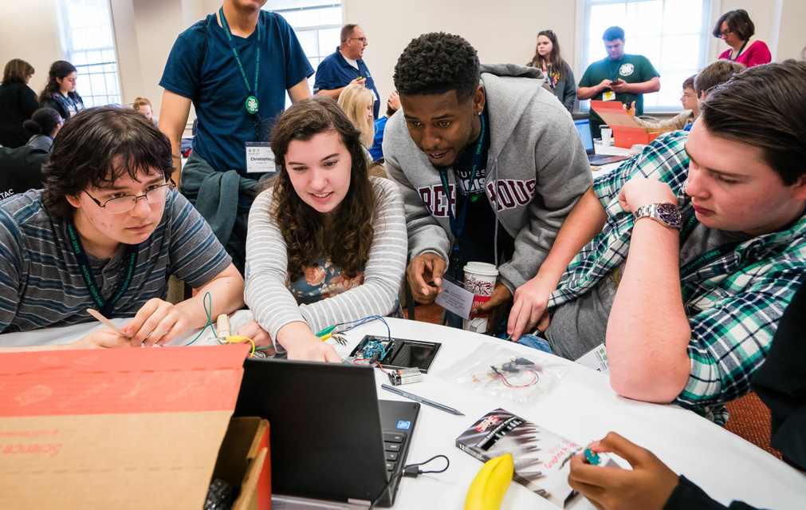
Technology Skills
Include use of:
the Internet,
software applications, and
digital devices.
Negative perceptions of technology by adults, especially those with strong voices, may jeopardize the utilization of potentially helpful changes (Lewis and Worker, 2016).

Slide 63
Digital Literacy
an individual’s ability to:
find,
evaluate, and
compose information
on digital platforms, which could include writing, illustrating, and producing music or videos.
For youth, digital literacy skills can have a positive impact on confidence, contribution, and connection (4-H Tech Changemakers, 2020).

Slide 64

Tips to Embrace Technology
Model a positive attitude towards technology
Seek help from others
Set realistic expectations
Be aware of pitfalls or limitations of the technology

Slide 65
For more information, contact:
Your Name, Your Title
your-email@fourhcouncil.edu

Slide 66
Activity – Instruction Prompts
Technology Skills – Communications Domain

Slide 67
Activity: Exploring the Benefits of Technology
Brainstorm examples of “Technology” in this space.
In small groups, discuss answers to the following questions:
What benefits can technology provide to you?
What benefits can technology provide to the youth you work with?
Review and discuss.
Notes:
Activity Instructions
Exploring the Benefits of Technology
Lead in: When someone mentions “technology” to you, what do you think of? What feelings does the word invoke?
As a group, brainstorm examples of technology in the room/space you are in.
Don’t forget some of the most basic forms of technology that we take for granted (e.g., writing utensils, clothing, shoes, hair products, glasses/contacts, etc.)
Next, in small groups, take 5-10 minutes to discuss the following two questions.
What benefits can technology provide to you?
What benefits can technology provide to the youth you work with?
Review and discuss.
Written by: T. Ashley Burns, Clemson University

Slide 68
Activity: Grow your Digital Literacy Skills
Individually, brainstorm a list of technology areas you would like to improve (personally) that could benefit your 4-H work.
Speed sharing!
For 60 seconds, find a partner with which to exchange 1 area of improvement and discuss.
Switch and repeat.
Discuss common skills and potential resources as a group.
Write a personal improvement plan for 1 skill.
Where to seek knowledge
How to practice
Notes:
Activity Instructions
Grow your Digital Literacy
As an individual, brainstorm a list of technology areas where you feel weak and would like to improve to benefit your 4-H work . (These can be specific or broad.)
Take approximately 10 minutes to mingle throughout the room.
Individuals will pair up for 60 seconds so that each person can share one area of technology where they would like to improve. If the partner is skilled in that area or knows of a good training resource, they can share.
When cued, individuals will find a new partner to share for 60 seconds.
Continue the process until 10 minutes are
Discuss.
Were there common themes shared? (This could inform future trainings.)
Did you find people you interacted with had the same weakness or complementary strengths? Were you able to share a good resource to help someone?
To wrap up this activity, have participants set a personal goal with a realistic timeline to gain knowledge and practice their skills related to one area of technology they would like to improve.
Written by: T. Ashley Burns, Clemson University

